Slide 1
Kodu Module 1 Slides
David S. Touretzky
Carnegie Mellon University

Slide 2
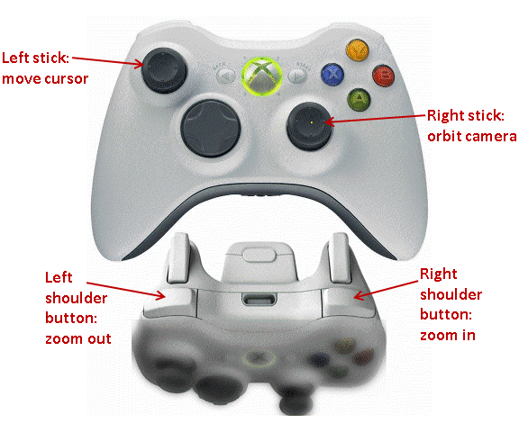
XBox Sticks and Shoulder Buttons

Slide 3
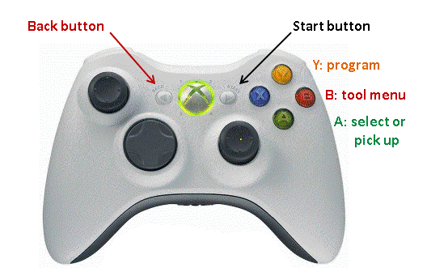
A-B-X-Y, Start, and Back Buttons

Slide 4
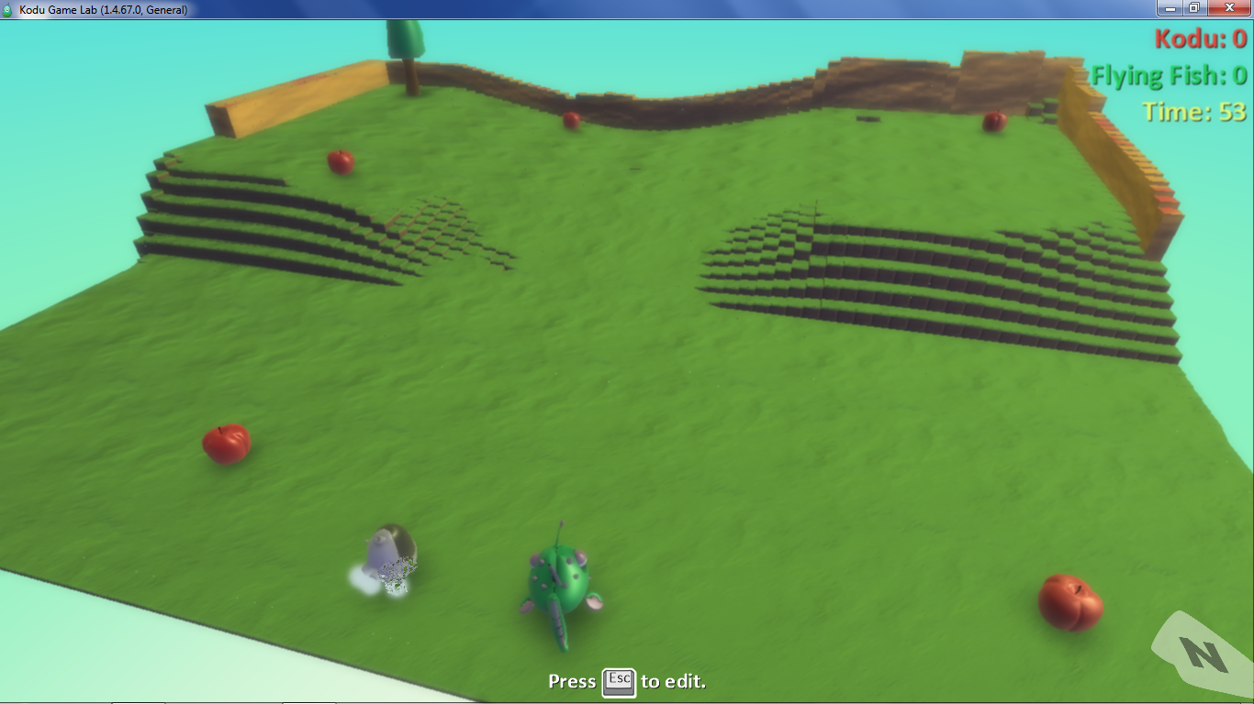
Apple1X World

Slide 5
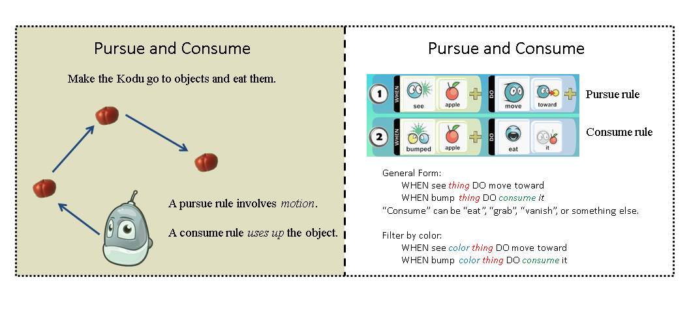
Pursue and Consume Idiom

Slide 6
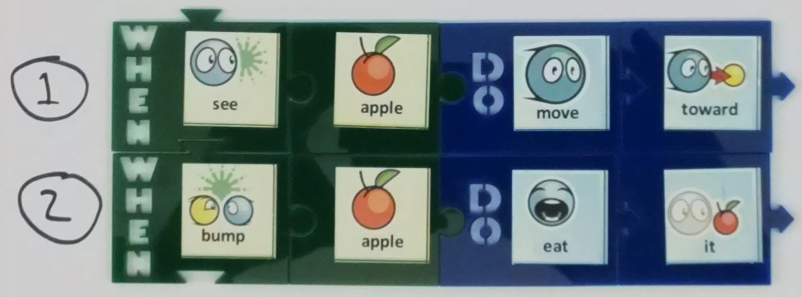
Tiles for Eating Apples

Slide 7
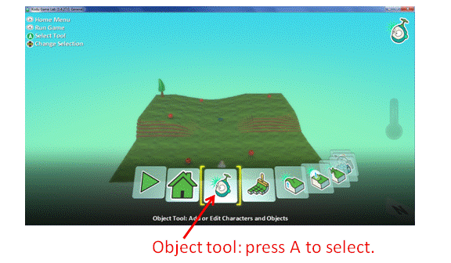
The Tool Menu

Slide 8
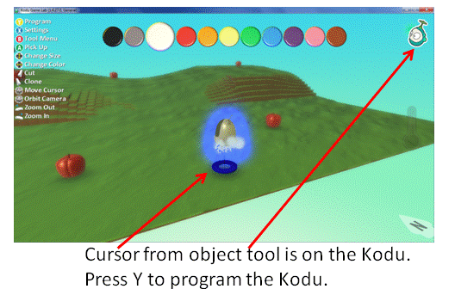
The Object Tool

Slide 9
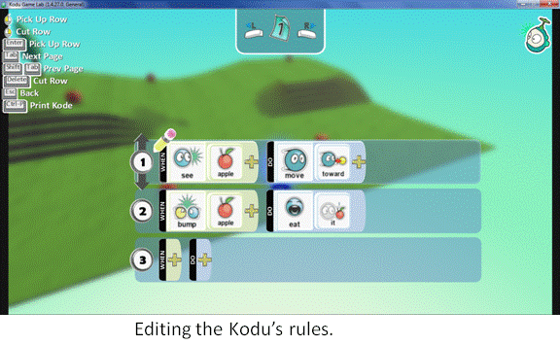
The Rule Editor

Slide 10
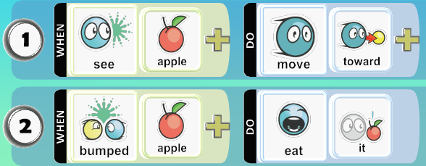
Eating Apples

Slide 11
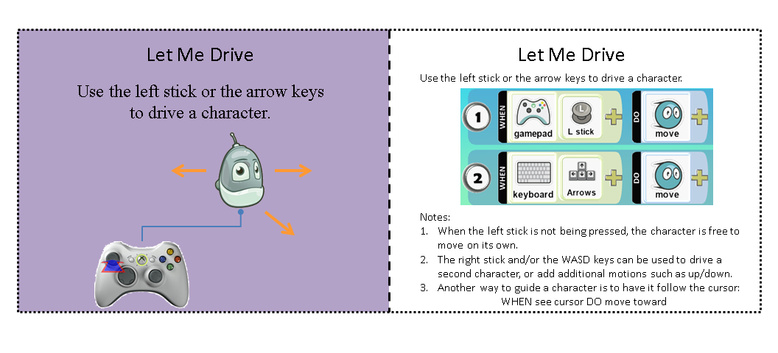
Let Me Drive Idiom

Slide 12
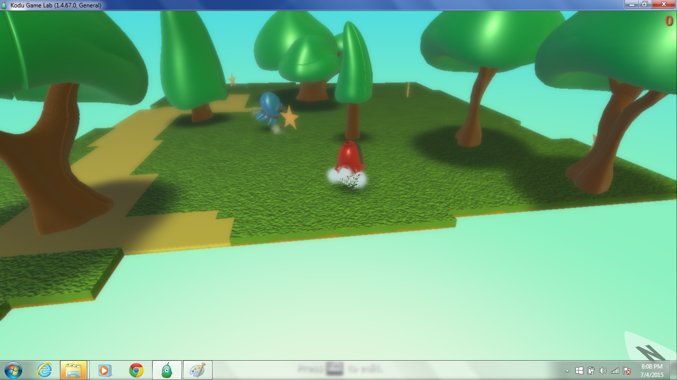
Star1X World

Slide 13
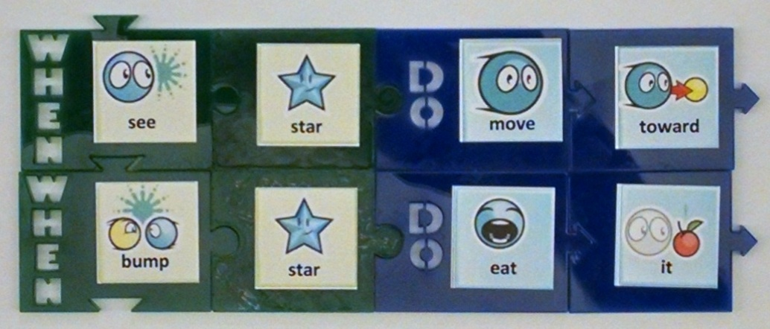
Tiles for Eating Stars

Slide 14
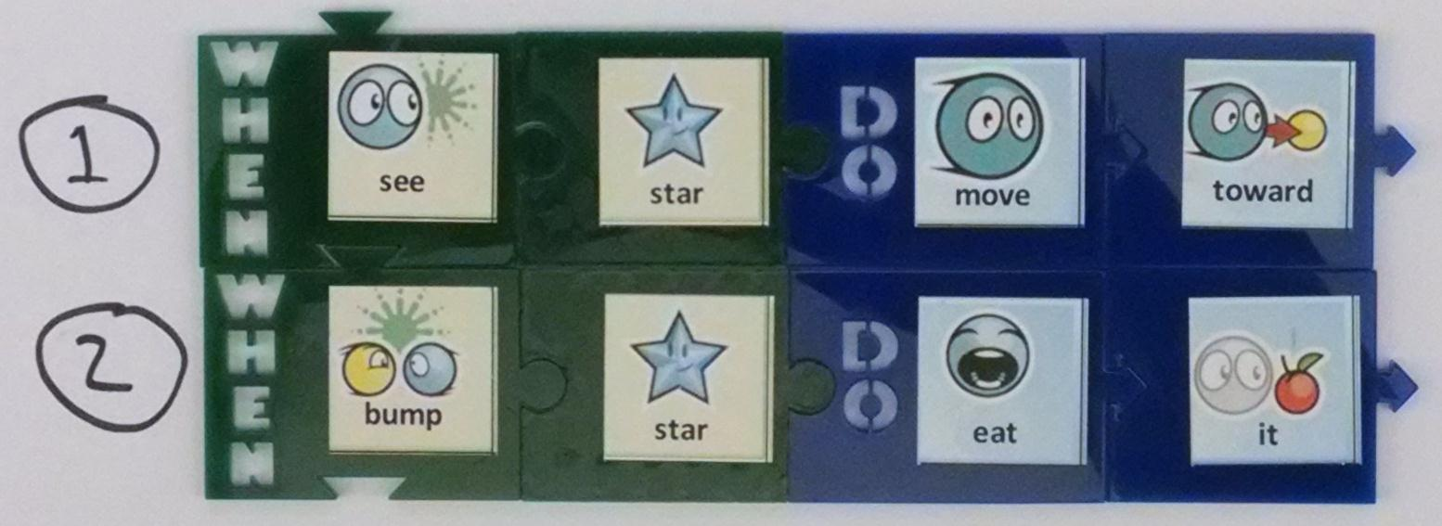
Tiles for Eating Stars

Slide 15
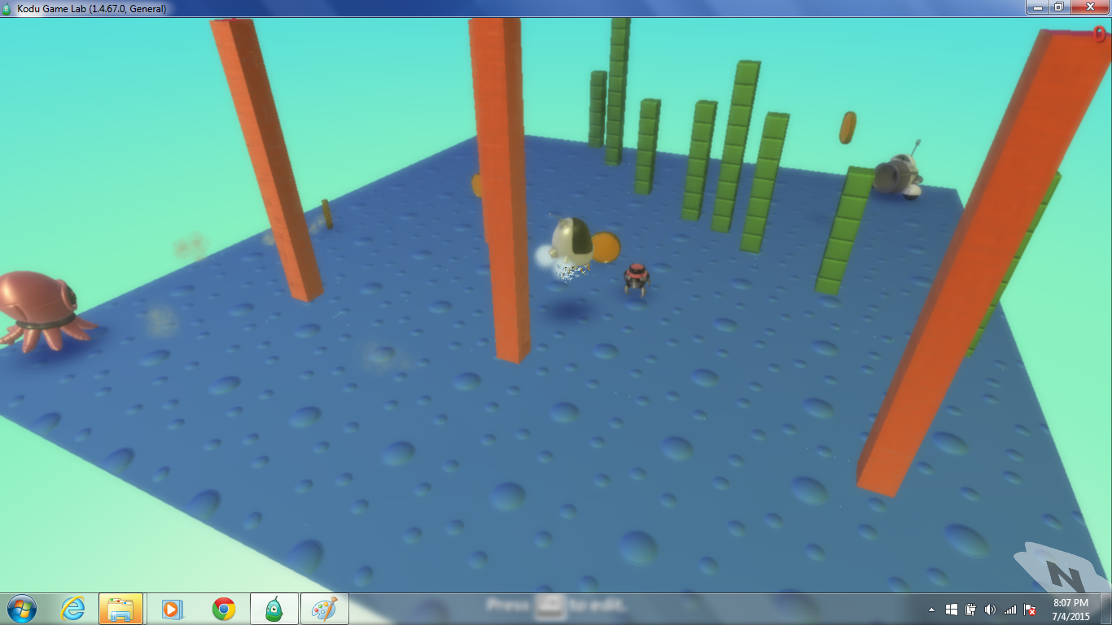
Flee1X World

Slide 16
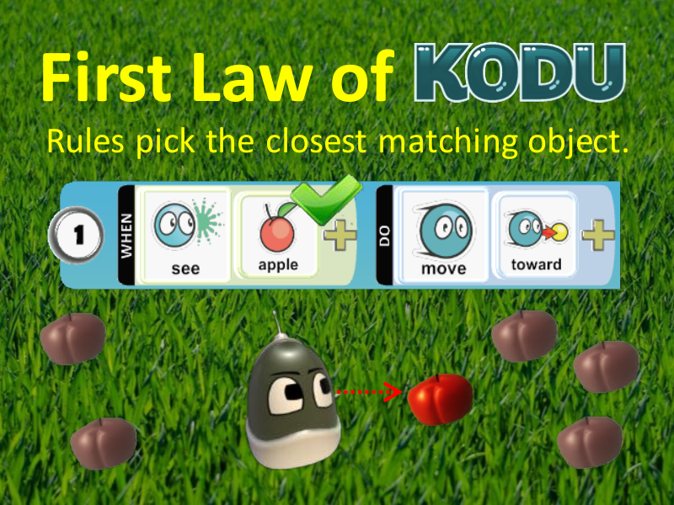

Slide 17
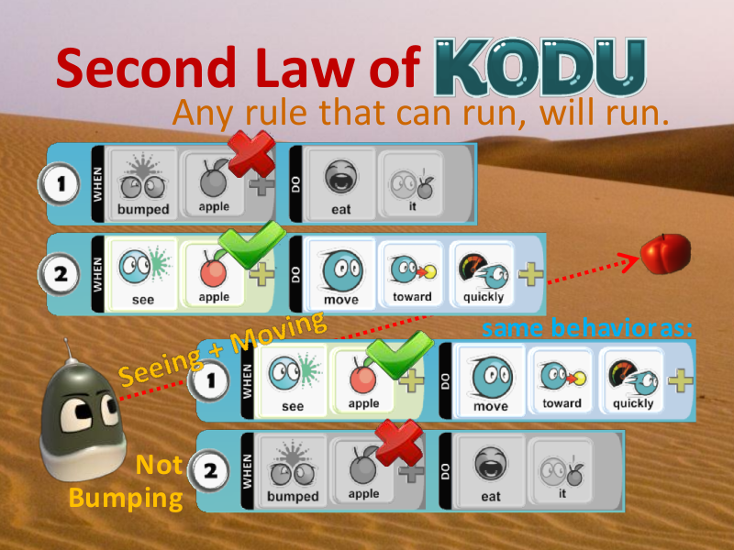

Slide 18
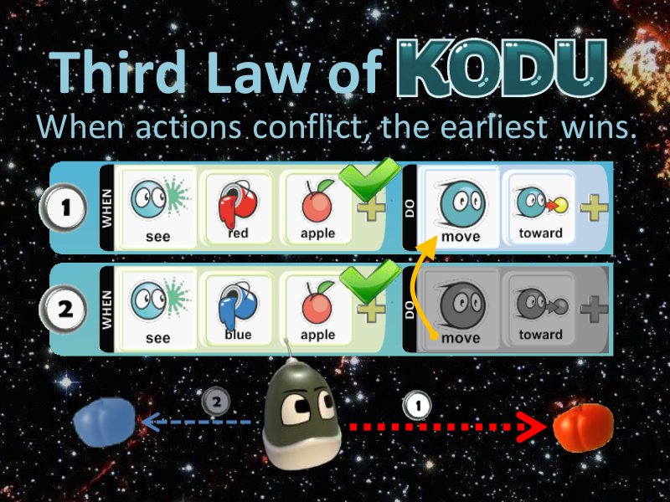

Slide 19
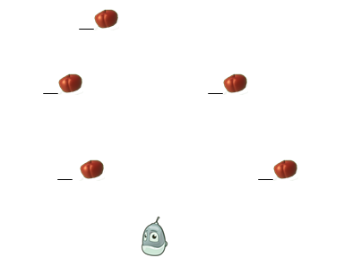
Review
In what order will the kodu eat the apples?

Slide 20
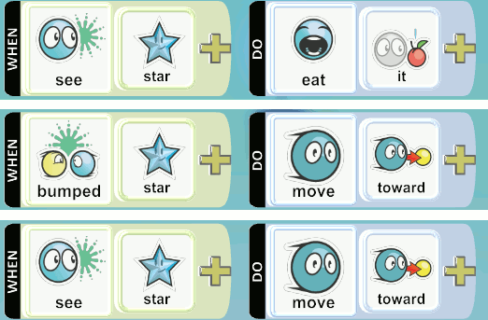
Review
Which rule says to go to the nearest star?

Slide 21
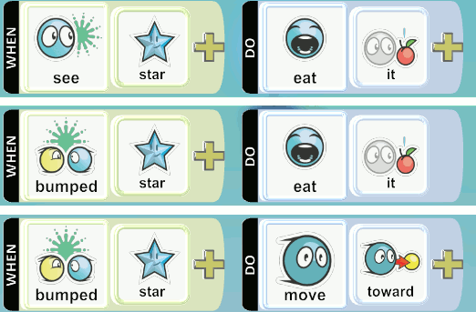
Review
Which rule tells the kodu to eat the star when it reaches it?

