Slide 1
Kodu Module 2 Slides
David S. Touretzky
Carnegie Mellon University

Slide 2
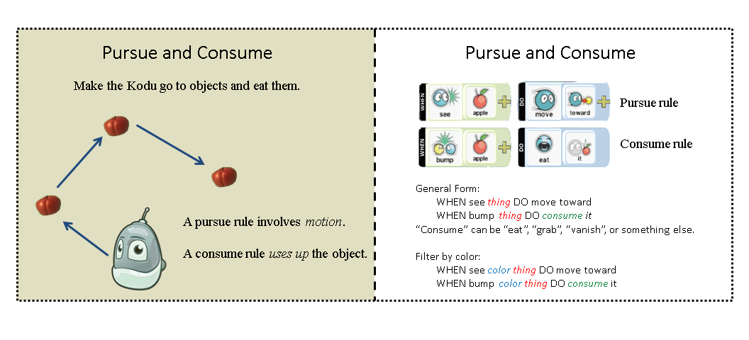
Pursue and Consume Idiom

Slide 3
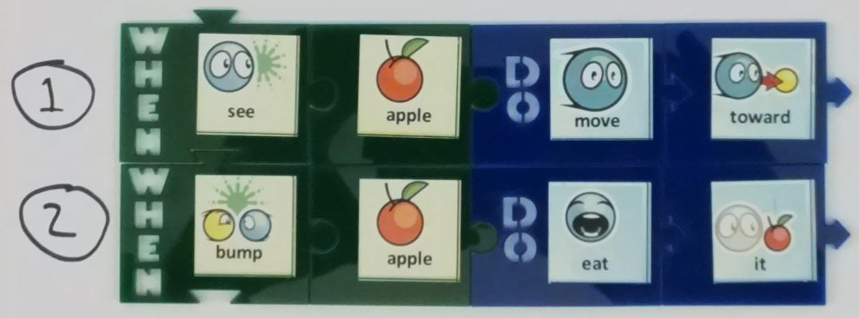
Tiles for Eating Apples

Slide 4
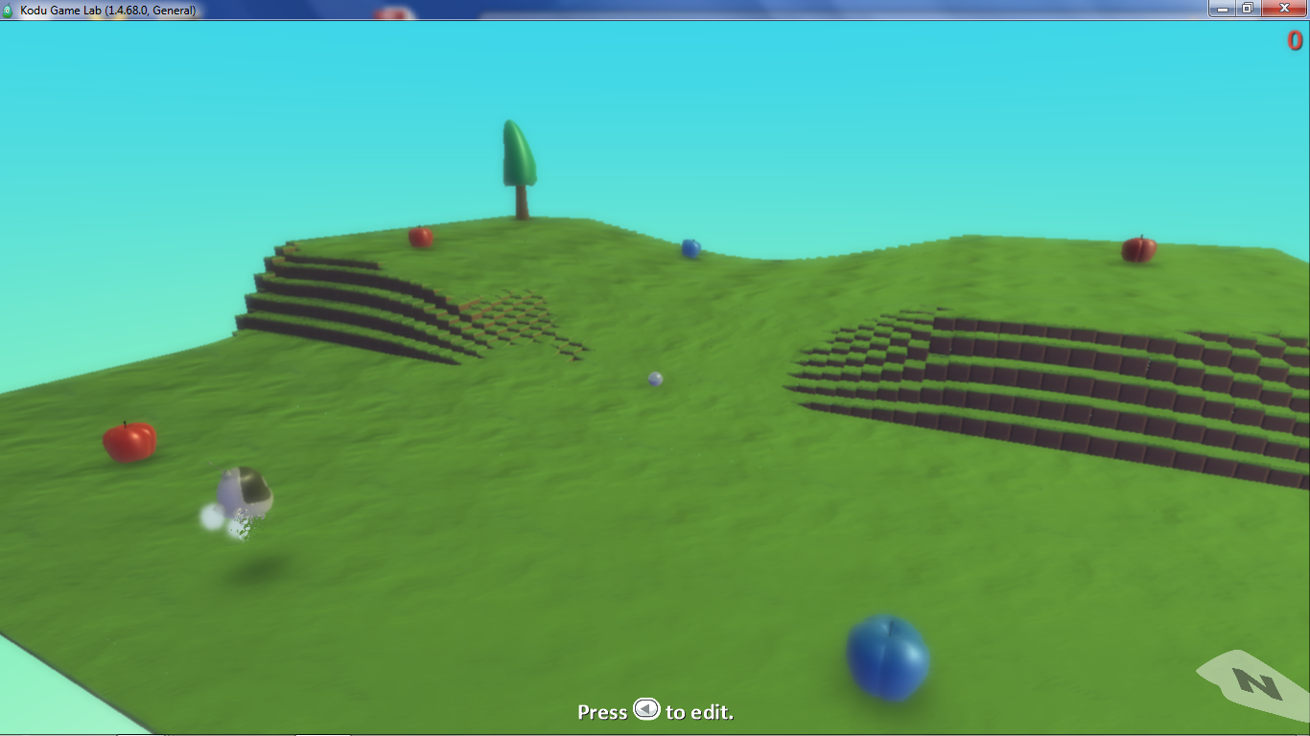
Apple2 World

Slide 5
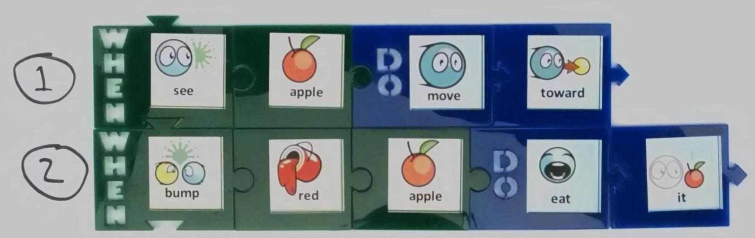
Only Eat Red Apples

Slide 6
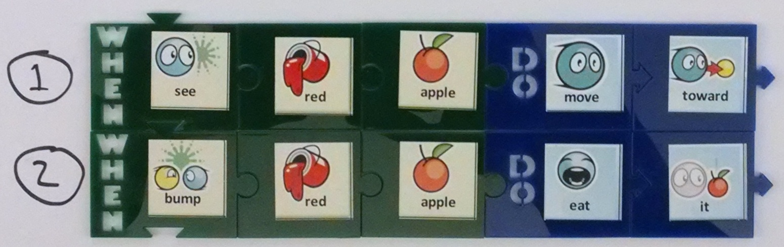
Pursue and Consume Red Apples

Slide 7
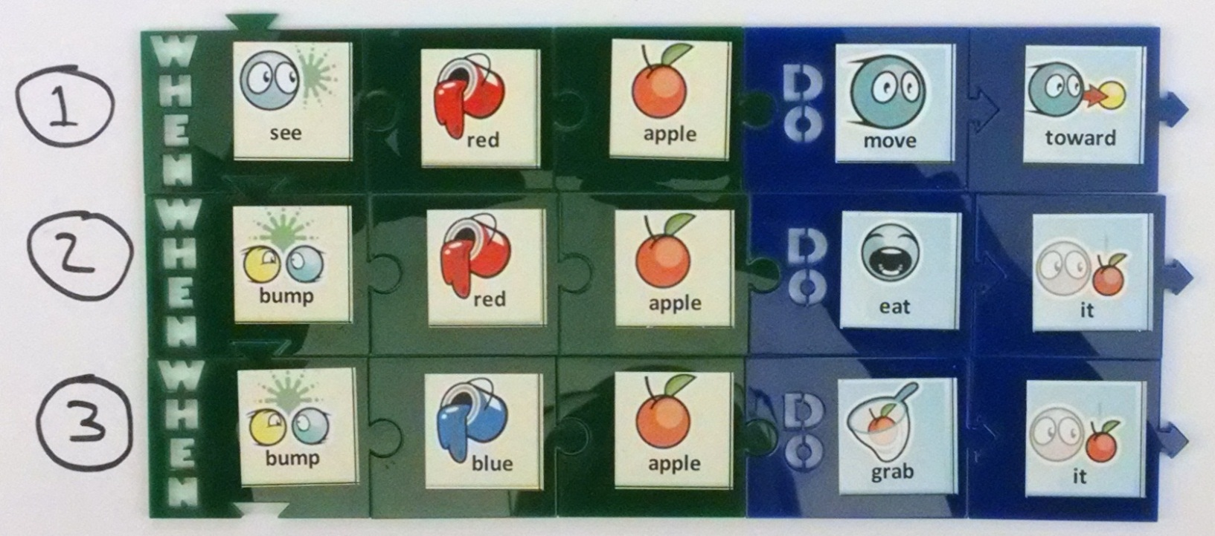
Eat Red Apples, Grab Blue Ones?

Slide 8
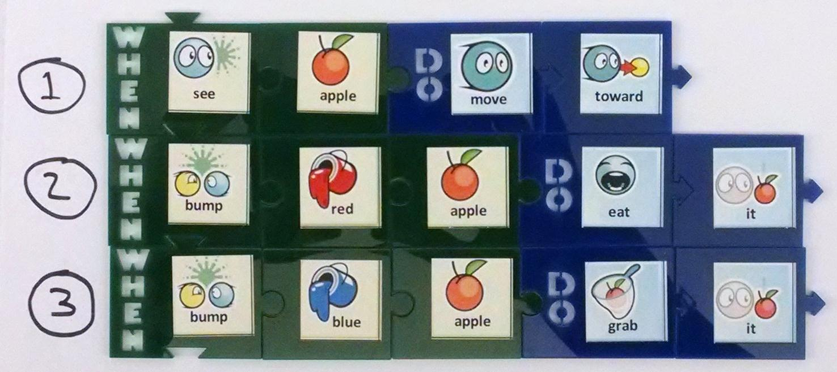
Eat Red Apples, Grab Blue Ones

Slide 9
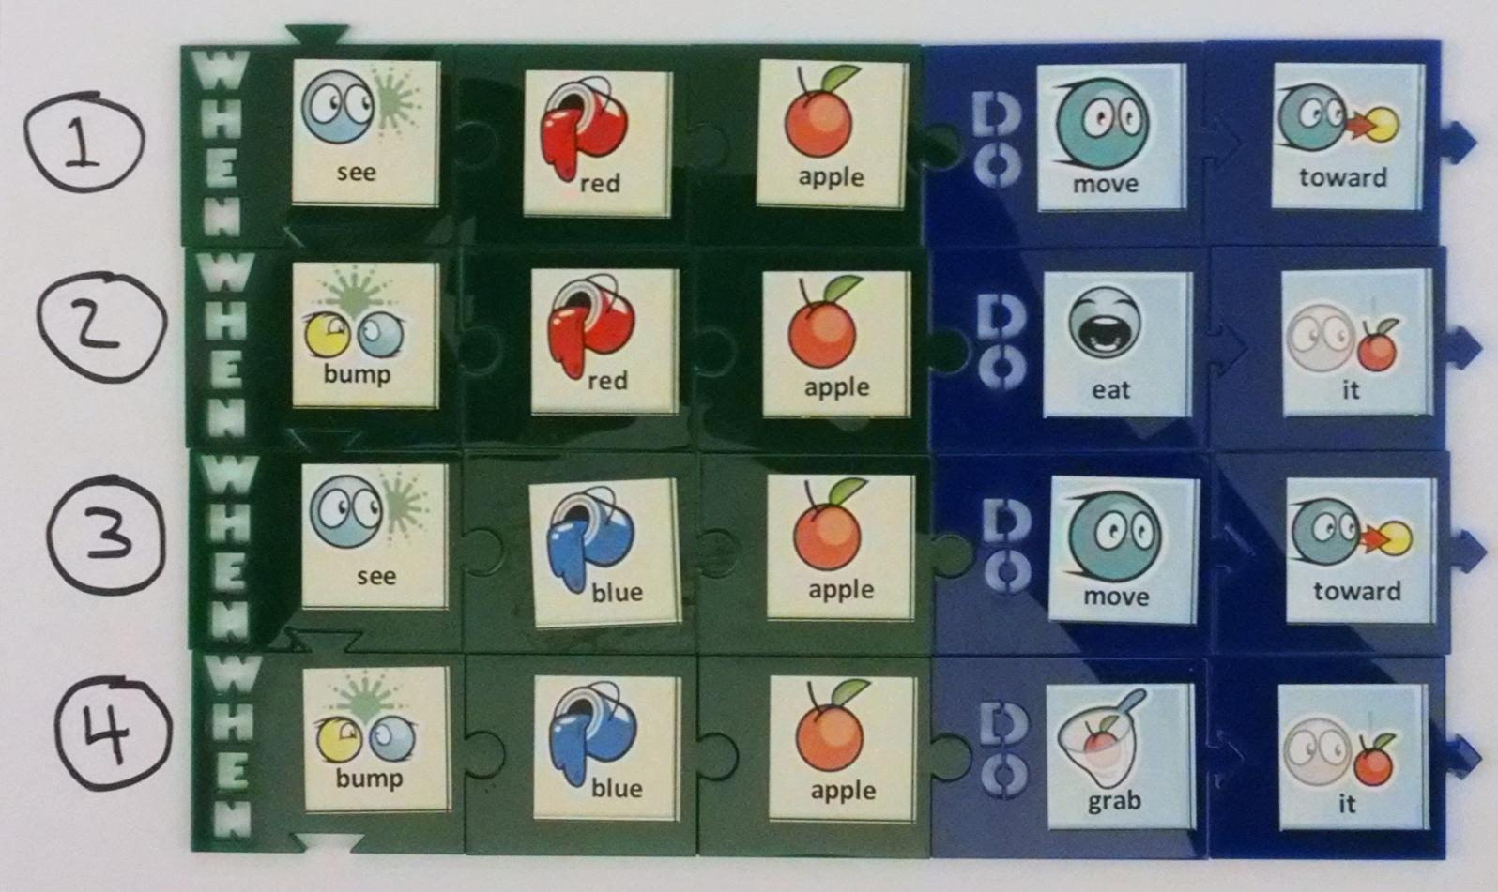
Non-Preferred Solution

Slide 10
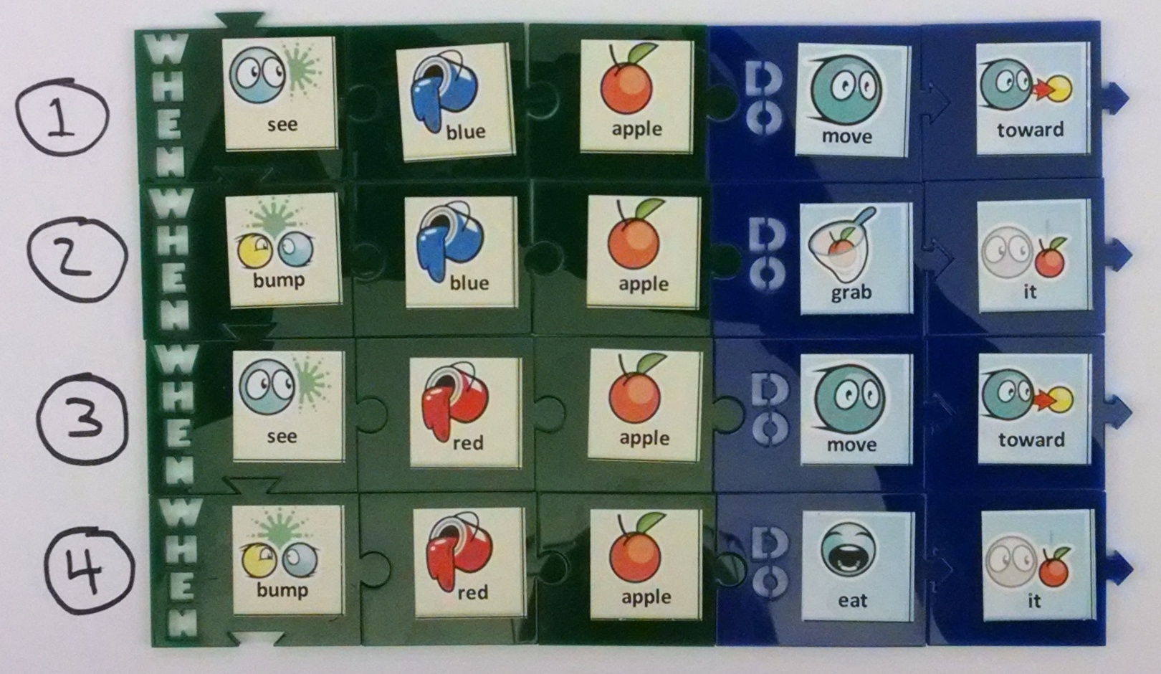
Non-Preferred, Different Order

Slide 11
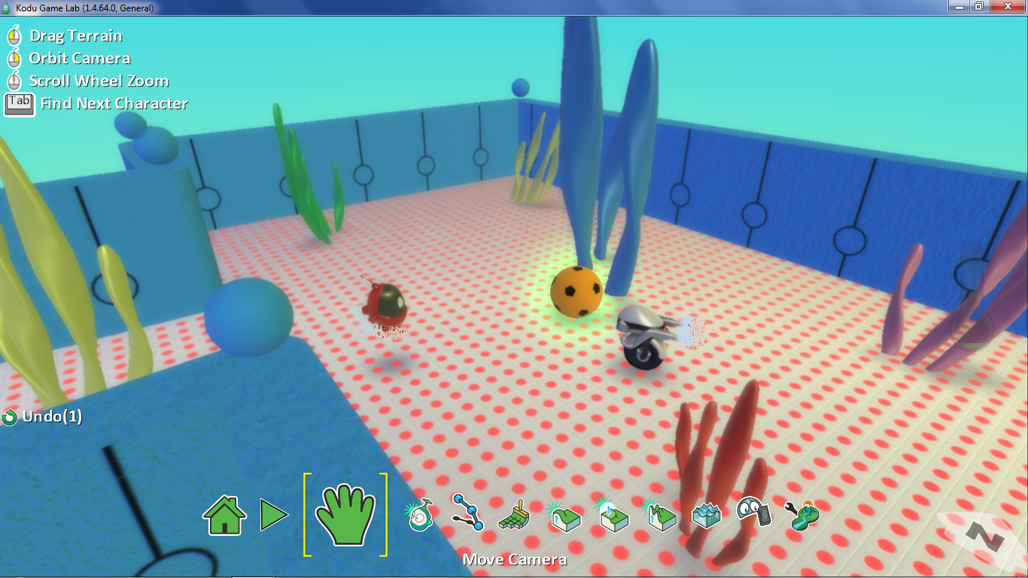
Ball1 World

Slide 12
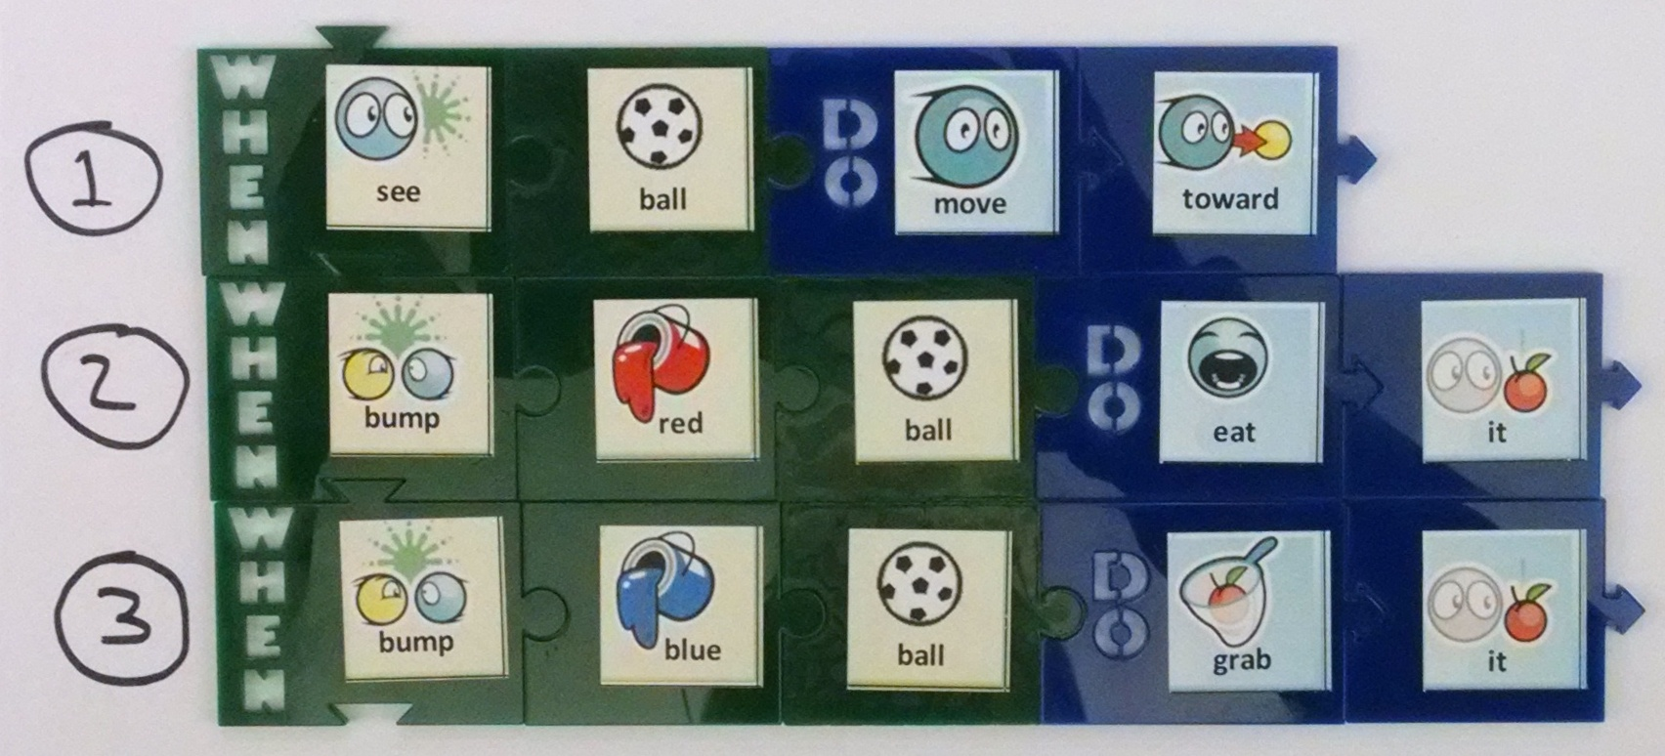
Tiles for Consuming Soccer Balls

Slide 13
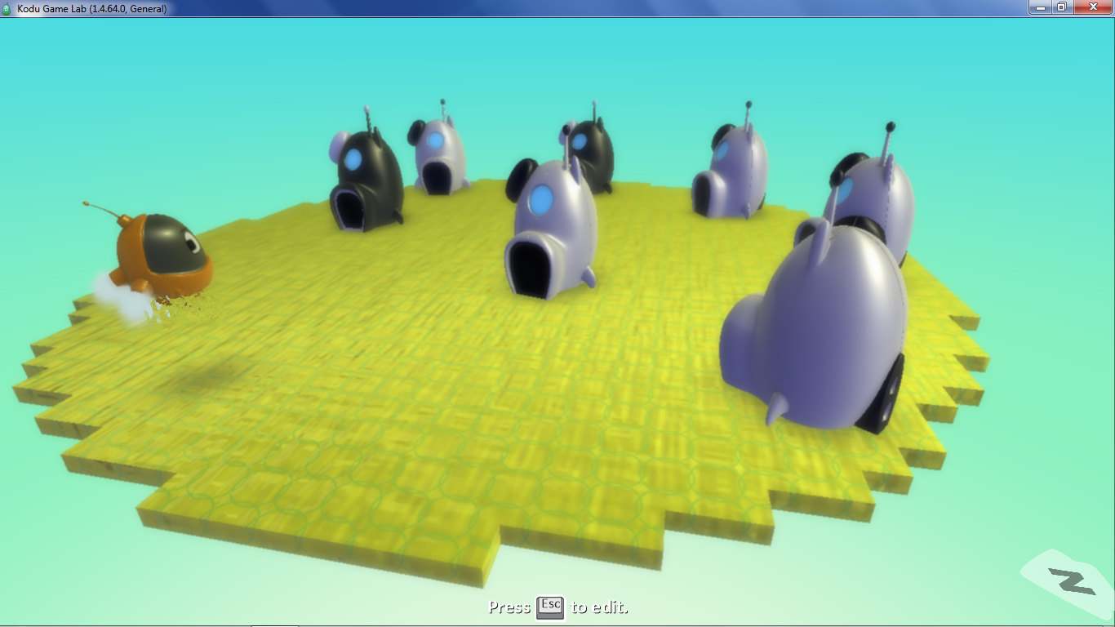
Paint1 World

Slide 14
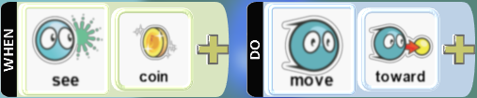
Pursue or Consume?

Slide 15

Pursue or Consume?

Slide 16

Pursue or Consume?

Slide 17

Pursue or Consume?

Slide 18
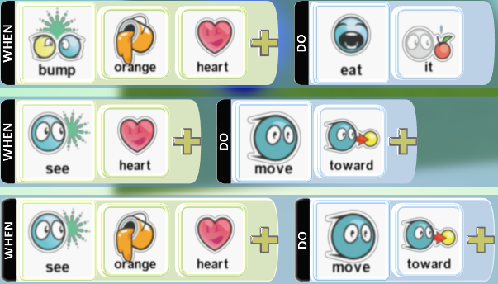
Which Rule Says to
Pursue Only Orange Hearts?

Slide 19
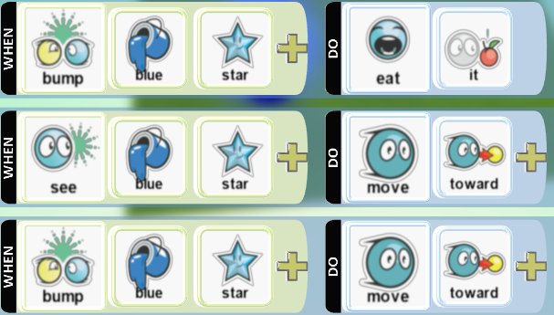
Which Rule Says to
Consume Only Blue Stars?

