Slide 1
Kodu Module 5 Slides
David S. Touretzky
Carnegie Mellon University

Slide 2
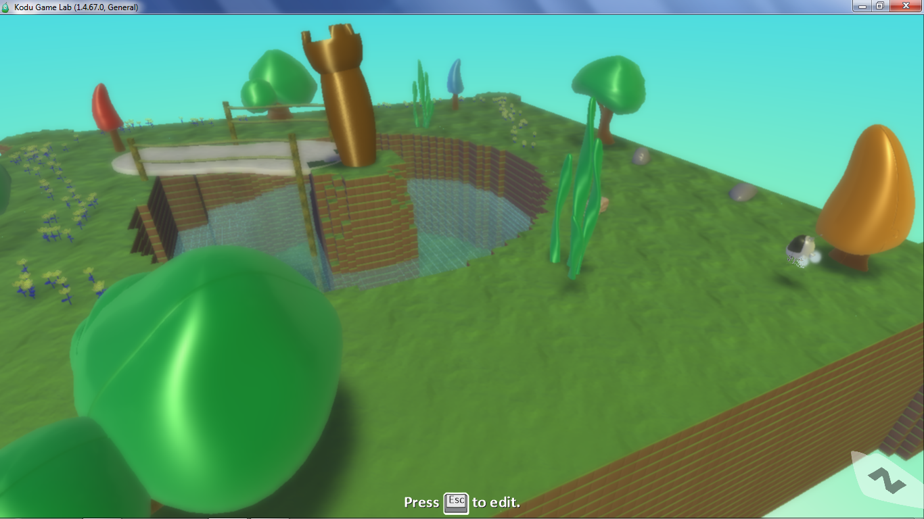
State1 World

Slide 3
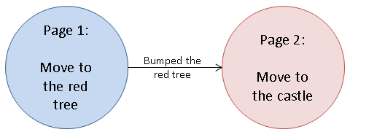
State Machine to Reach the Castle

Slide 4
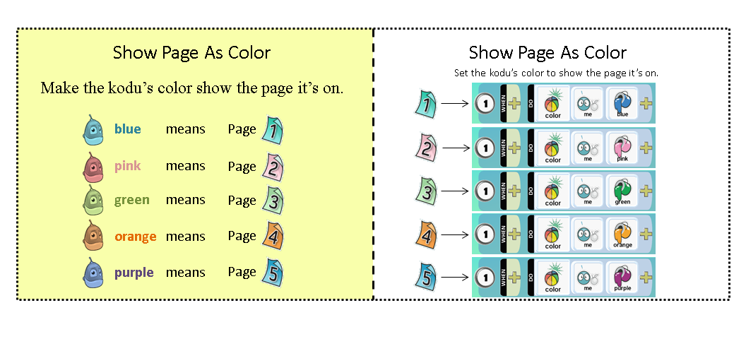
Show Page As Color Idiom

Slide 5
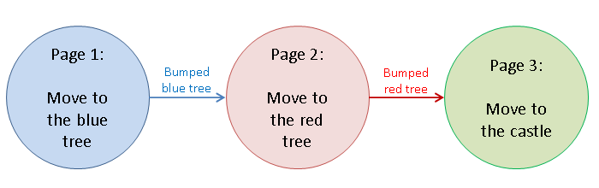
Harder Castle Problem

Slide 6
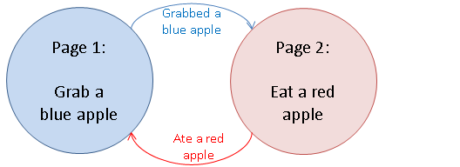
Alternate Red and Blue Apples

Slide 7
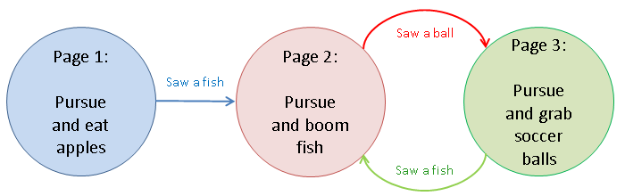
State Machine With Three Nodes

Slide 8
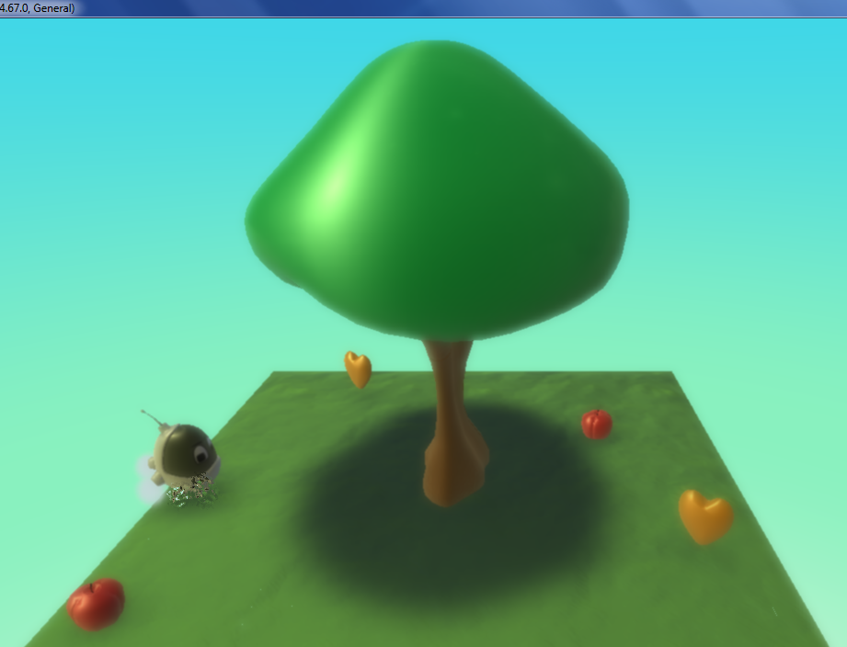
Draw This State Machine
PAGE 1:
[1] WHEN DO color me blue
[2] WHEN see tree DO move toward
[3] WHEN bump tree DO switch to page 2
PAGE 2:
[1] WHEN DO color me pink
[2] WHEN see apple DO move toward
[3] WHEN bump apple DO eat it
 [4] WHEN DO play coin
PAGE 3:
[1] WHEN DO color me green
[2] WHEN see heart DO move toward
[3] WHEN bump heart DO grab it
 [4] WHEN DO switch to page 2

Slide 9
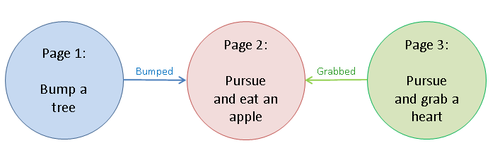
Answer to Draw State Problem

Slide 10
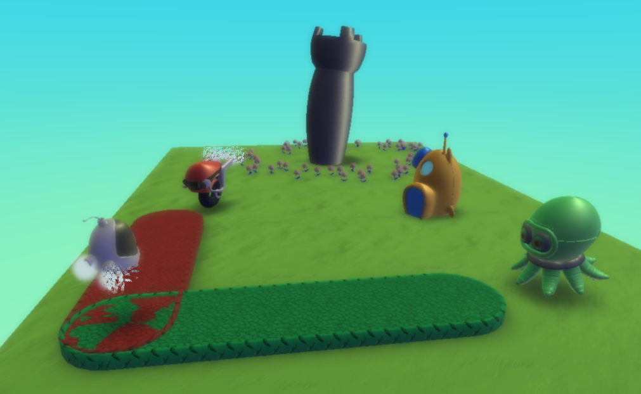
Race: Cycle vs. Octopus
PAGE 1:
[1] WHEN bump octopus DO switch to page 2
[2] WHEN bump cycle DO switch to page 3
PAGE 2:
[1] WHEN see hut DO move toward
[2] WHEN bump hut DO switch to page 3
PAGE 3:
[1] WHEN see castle DO move toward
[2] WHEN bump castle DO win

Slide 11
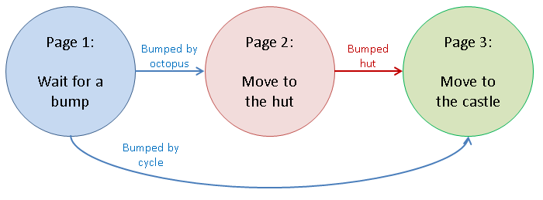
Cycle vs. Octopus Answer

