Slide 1
Kodu Module 6 Slides
David S. Touretzky
Carnegie Mellon University

Slide 2
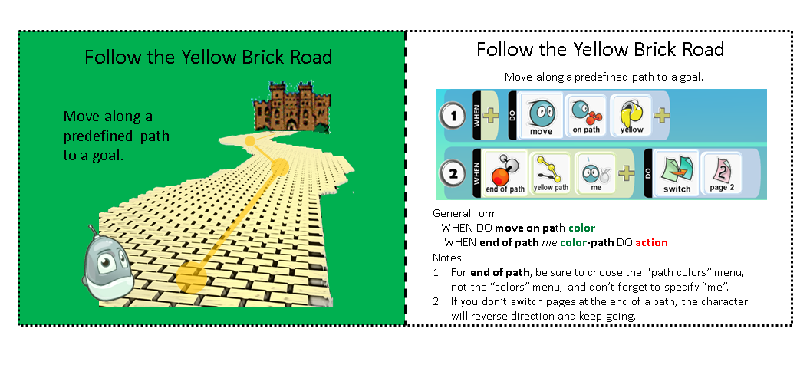
Follow the Yellow Brick Road Idiom

Slide 3
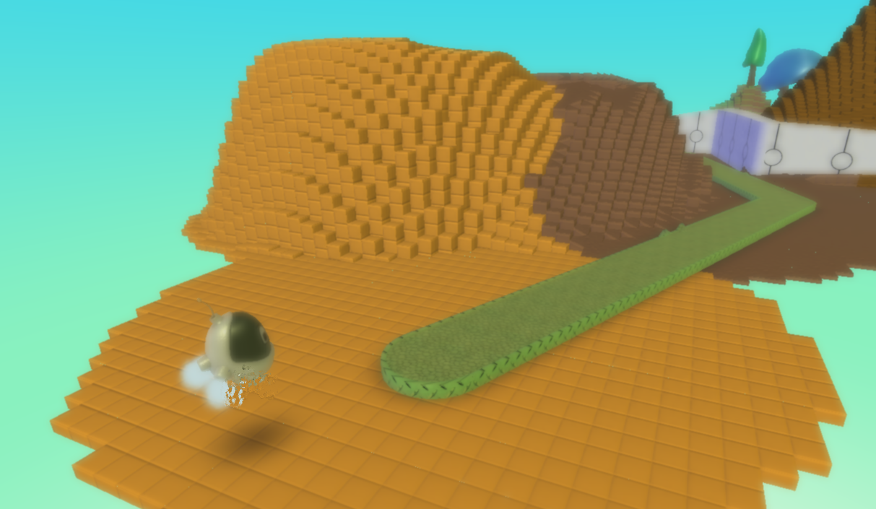
Path1 World

Slide 4
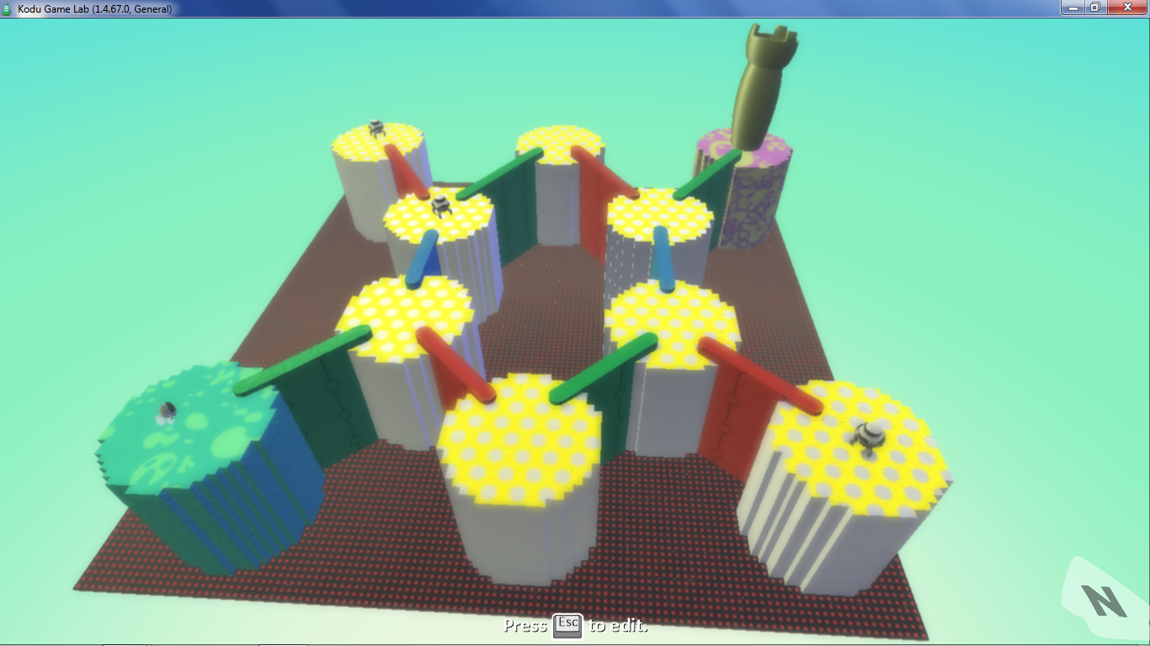
HexGraph1 World

Slide 5
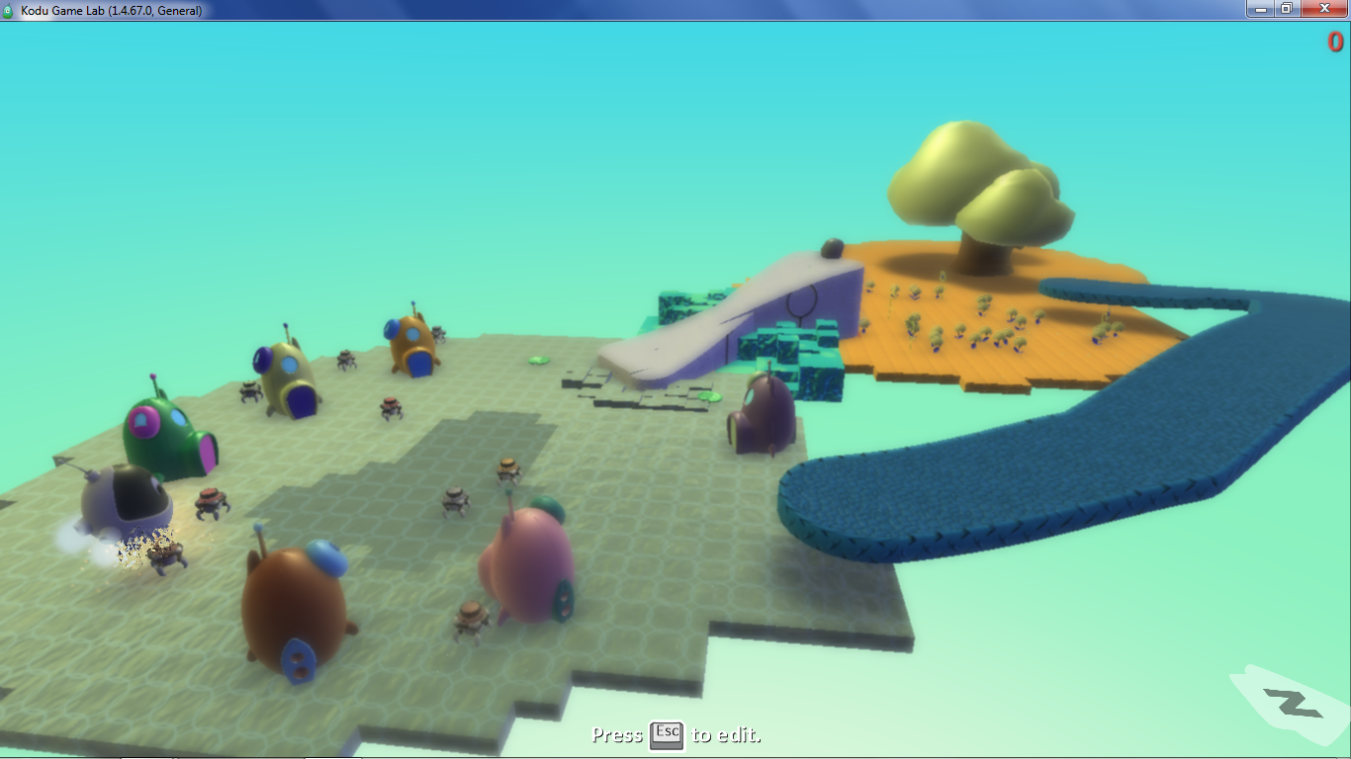
Ants1 World

Slide 6
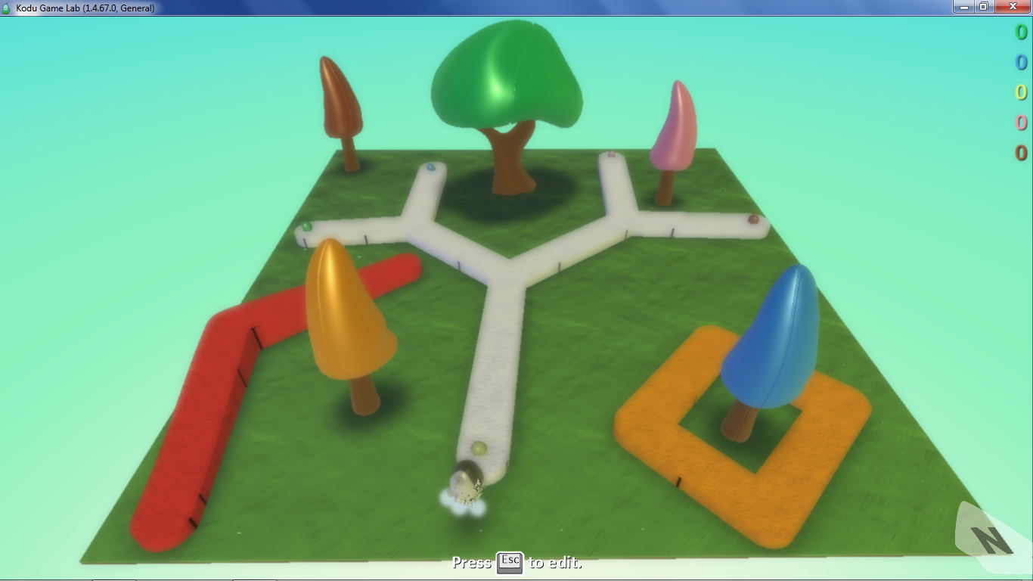
ForkedPath1 World

Slide 7
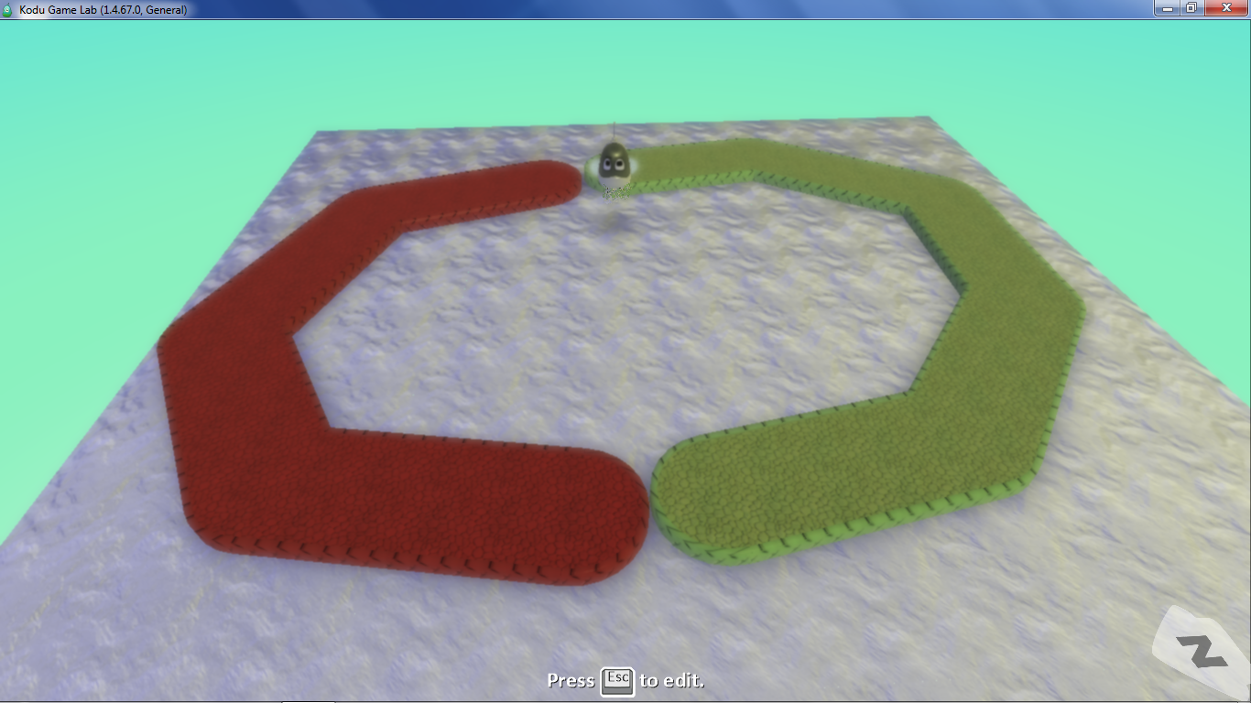
A Path Cycle

Slide 8
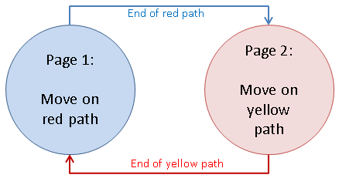
Path Cycle Answer

