Slide 1
Kodu Module 3 Slides
David S. Touretzky
Carnegie Mellon University
December 16, 2015

Slide 2
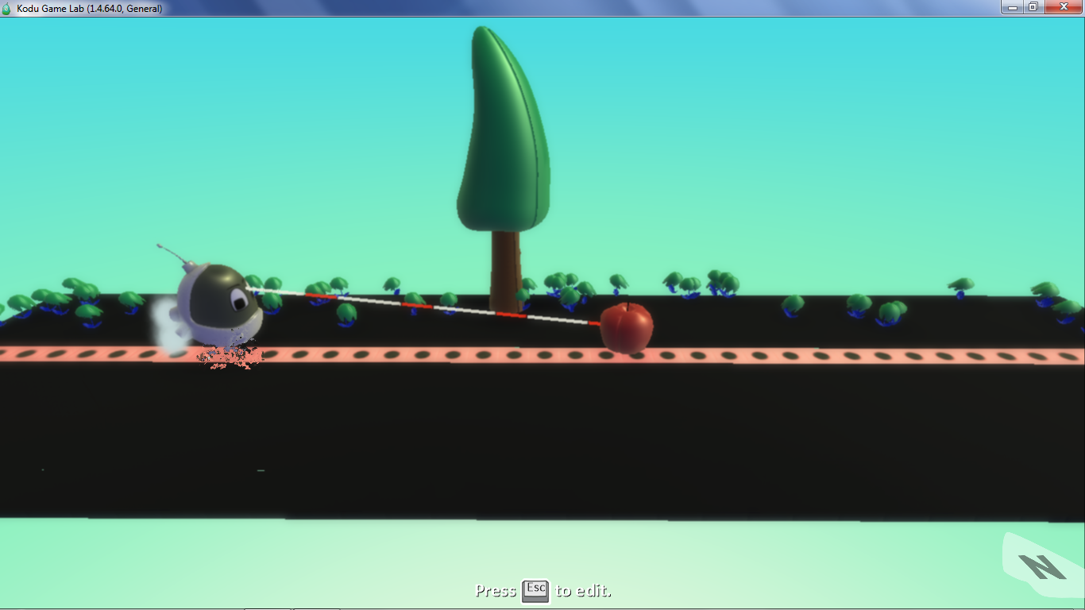
Measure1 World

Slide 3
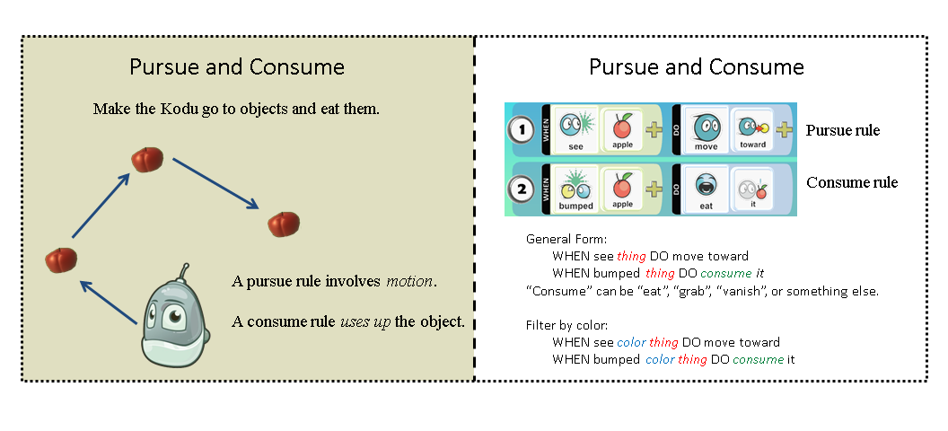
Pursue and Consume Idiom

Slide 4
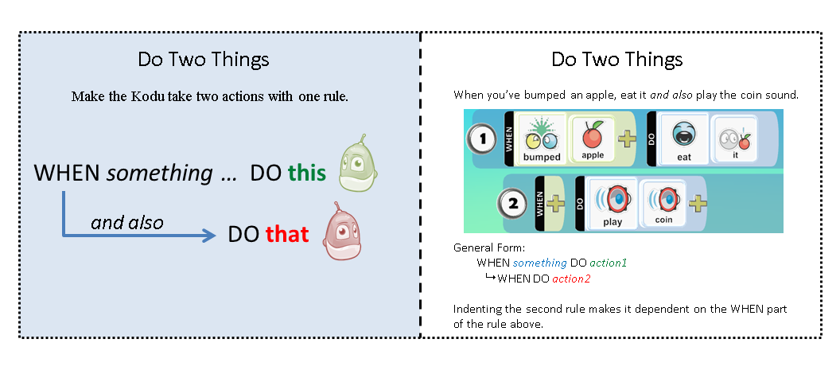
Do Two Things Idiom

Slide 5
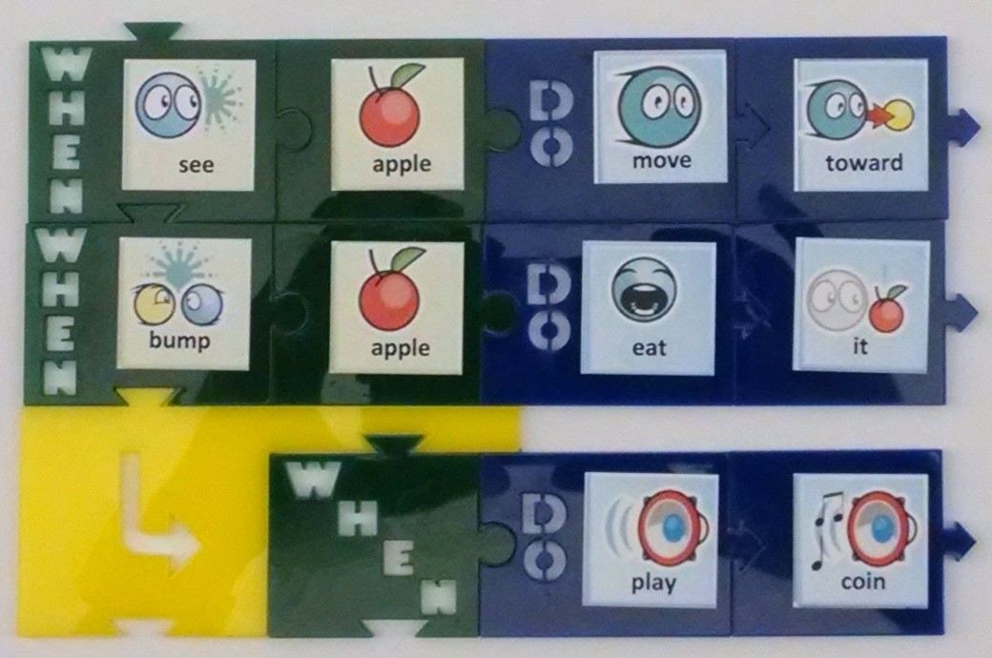
Eat An Apple and Play A Sound

Slide 6
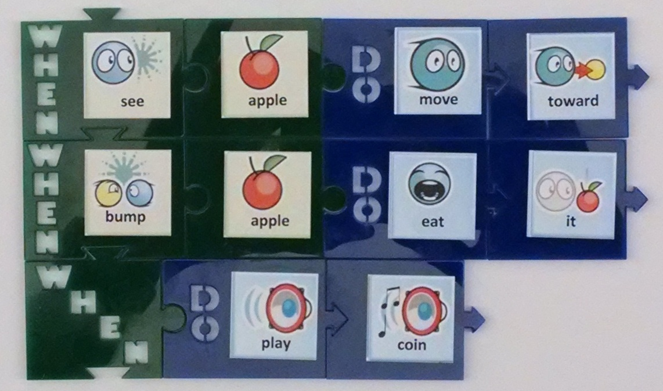
Missing Indentation

Slide 7
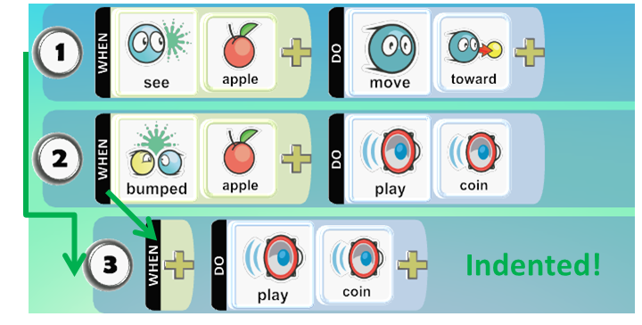
Rule 3 Is Indented
The rule number and WHEN marker are both indented relative to rule 2.

Slide 8
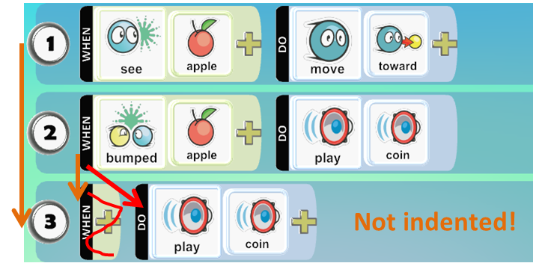
Rule 3 Is Not Indented
Don’t compare the WHEN part of rule 2 against the
DO part of rule 3.

Slide 9
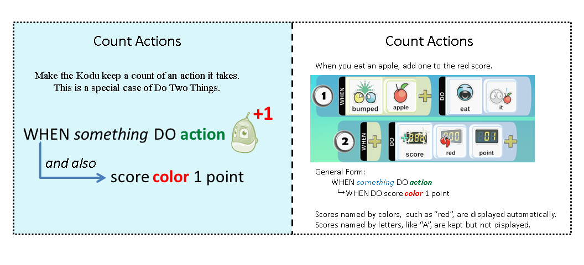
Count Actions Idiom

Slide 10
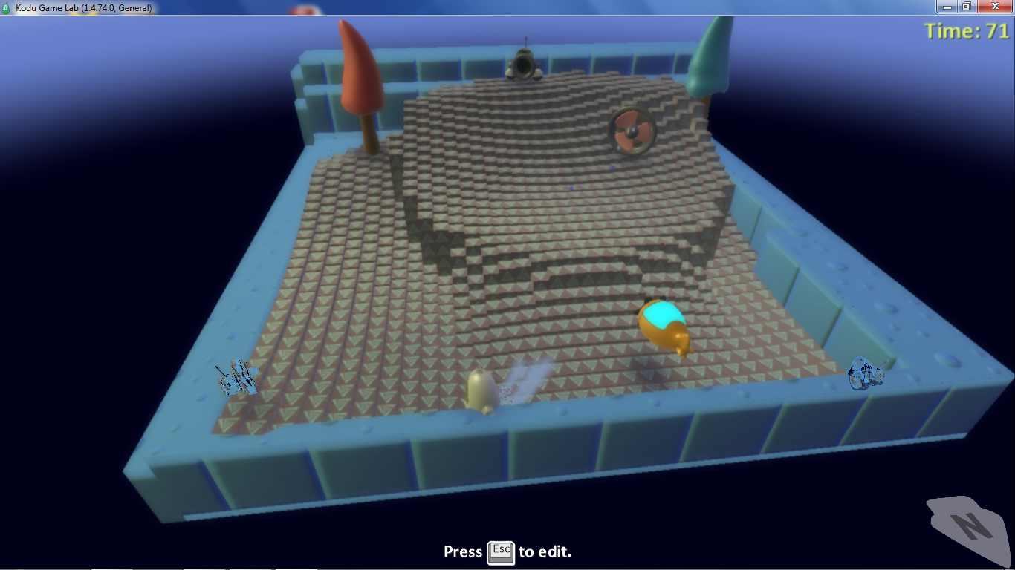
HeartCannon1X World

Slide 11
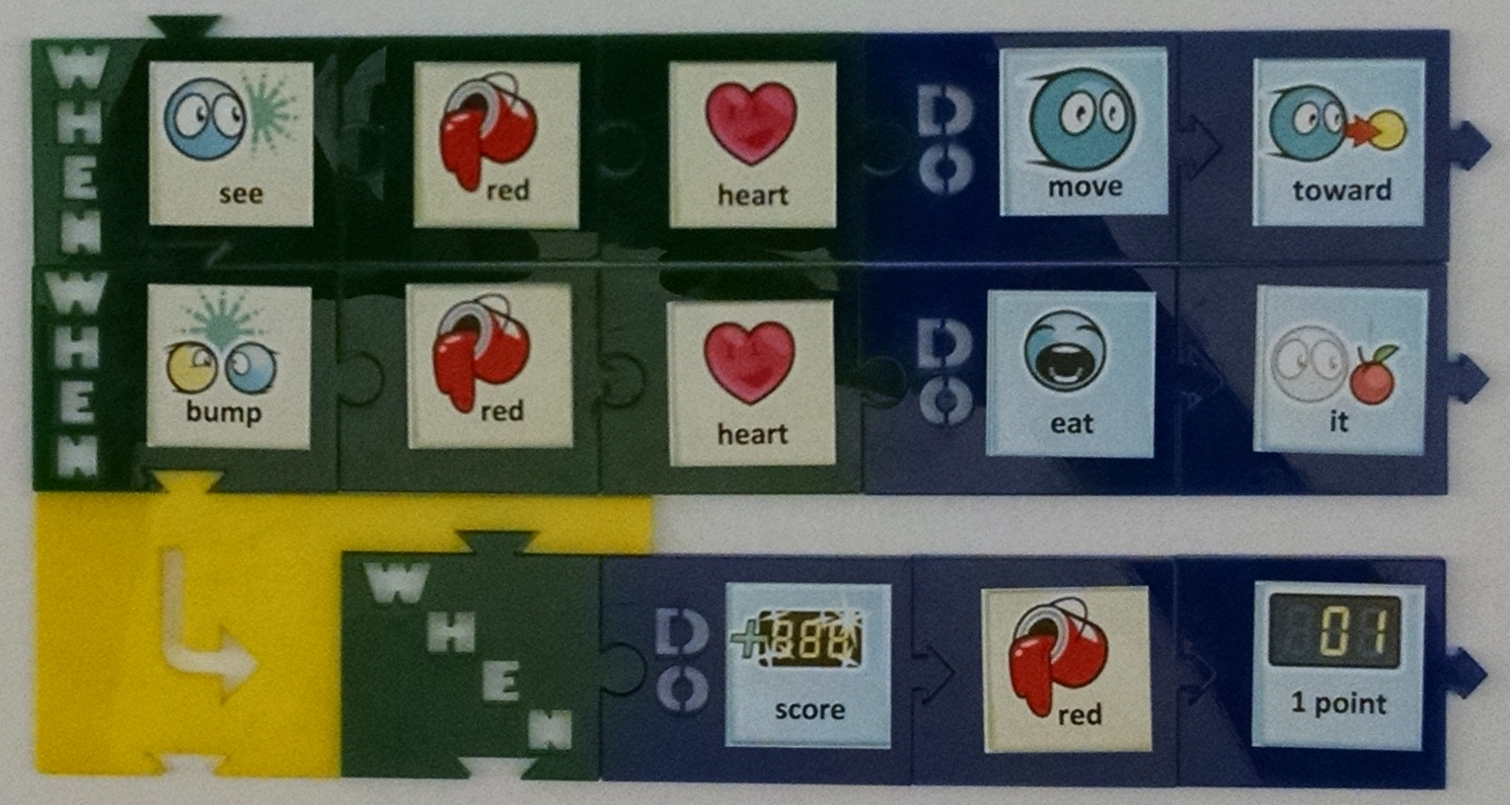
Eat and Count Red Hearts

Slide 12
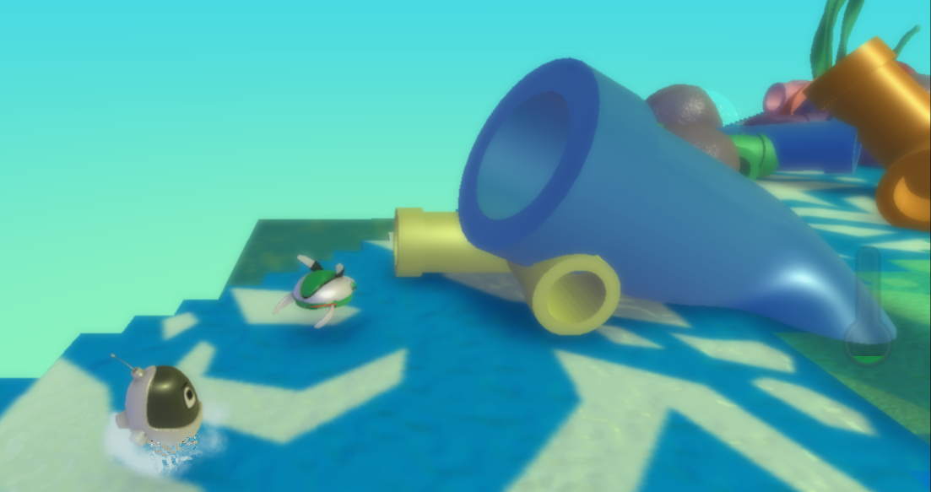
BoomPipes1 World

Slide 13
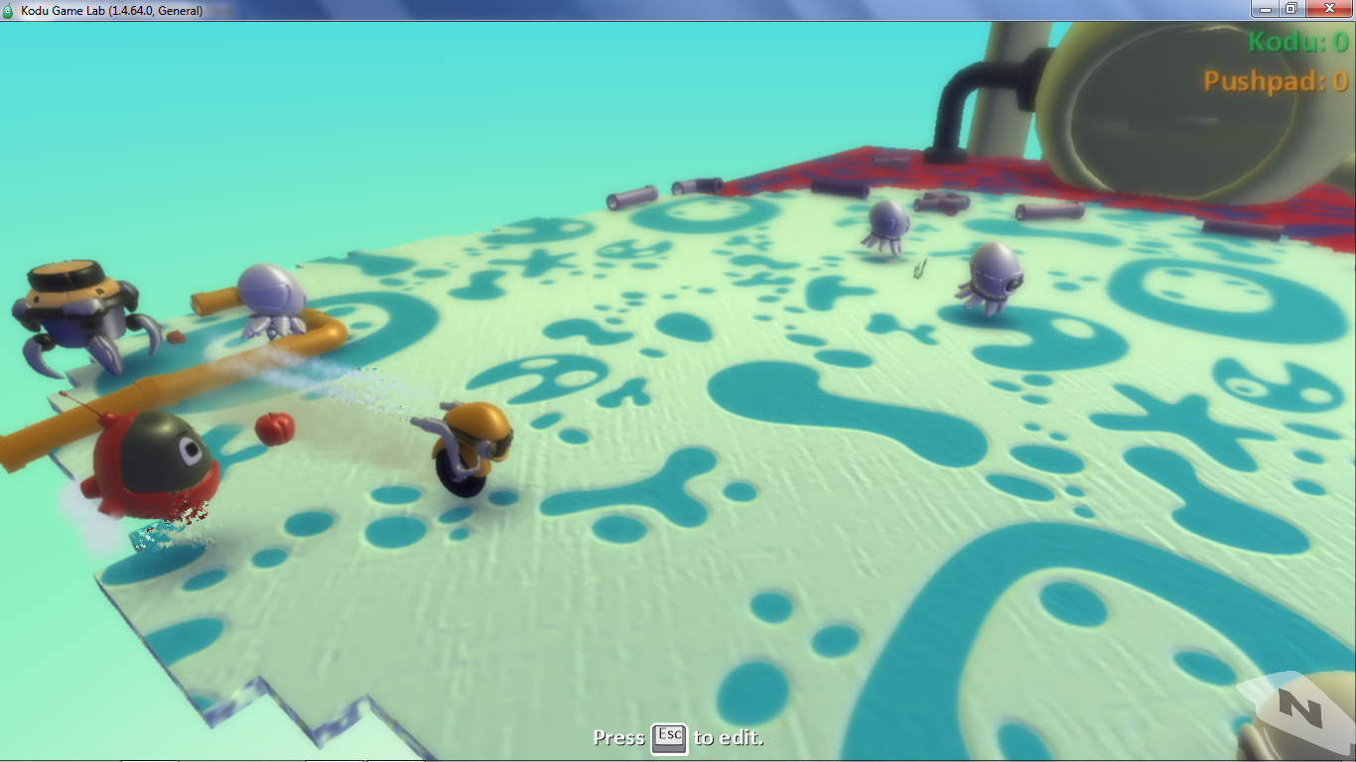
Giver1 World

Slide 14
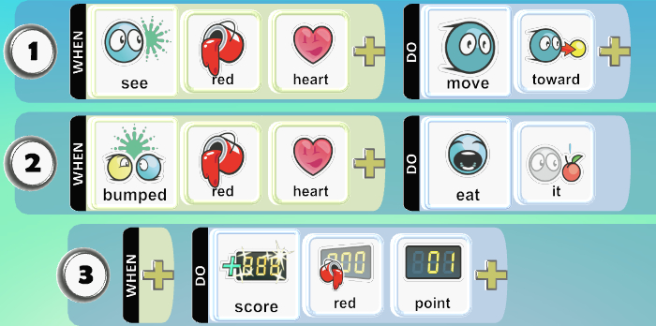
Two Idioms Combined
Which rules implement Pursue and Consume?
Which rules implement Count Actions?

Slide 15
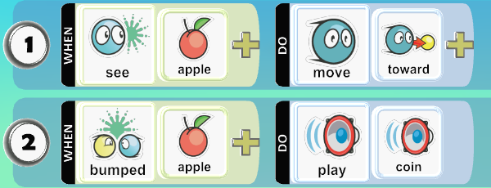
What Do These Rules Do?

