Slide 1

User-Controllable Privacy:
A Multi-Disciplinary Perspective
Norman M. Sadeh
Mobile Commerce Lab.
ISR - School of Computer Science
Carnegie Mellon University
www.cs.cmu.edu/~sadeh

Slide 2
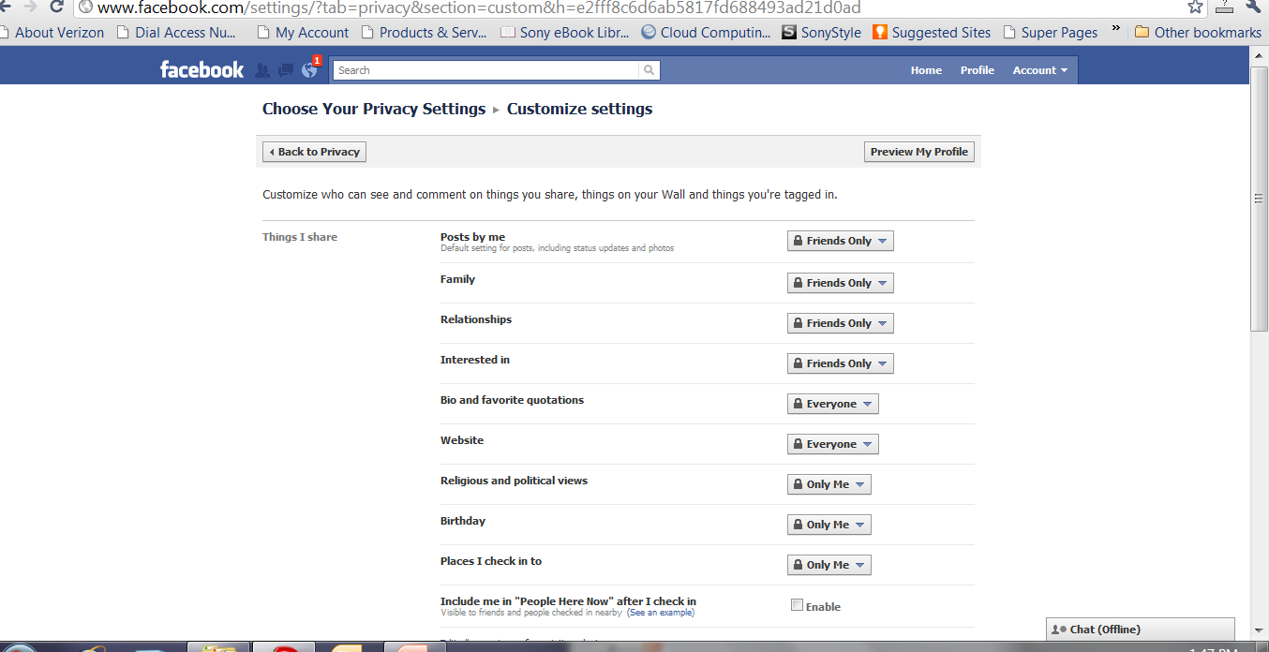
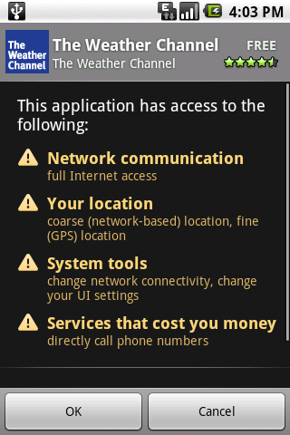
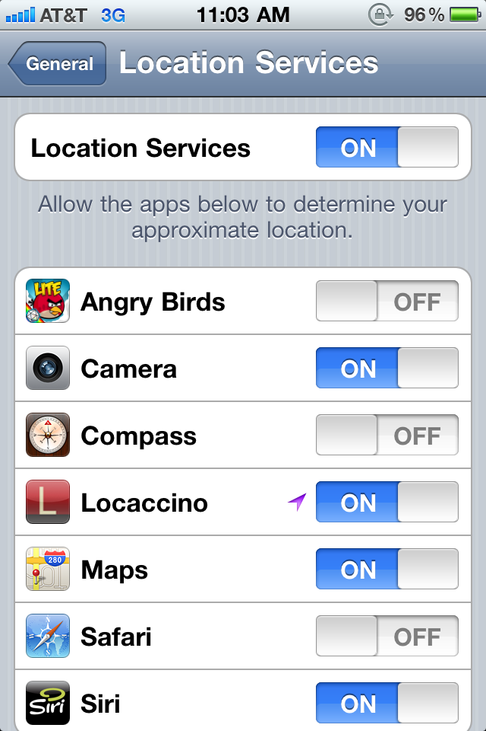


Slide 3
User-Controllable Privacy
Users are increasingly expected to evaluate & set up privacy policies
  Social networks
  Mobile Apps (e.g. Android Manifest)
  Browser
Yet, we know that they have great difficulty doing so
  Potential vulnerabilities
Can we develop solutions that help them?

Slide 4
Mobile Social Networking Apps As a Case Study
Desire to share data with others
Mitigated by privacy concerns
Location sharing as a “hot” application
  Tens of apps over the past several years
  …but adoption has been slow
Norman Sadeh, Jason Hong, Lorrie Cranor, Ian Fette, Patrick Kelley, Madhu Prabaker, and Jinghai Rao. Understanding and Capturing People’s Privacy Policies in a Mobile Social Networking Application Journal of Personal and Ubiquitous Computing 2009.

Slide 5
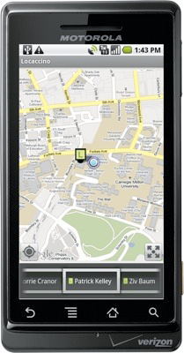
Our Own Location Sharing Platform
Gives us access to detailed usage data
Allows us to experiment with different technologies
Over 30,000 downloads over the past year (> 130 countries)
Departs from commercial apps:
  More expressive privacy settings
  Auditing functionality
  New technologies (e.g. UCPL)
Available on Android Market, iPhone App Store, Ovi Store, laptop clients
www.locaccino.org

Slide 6
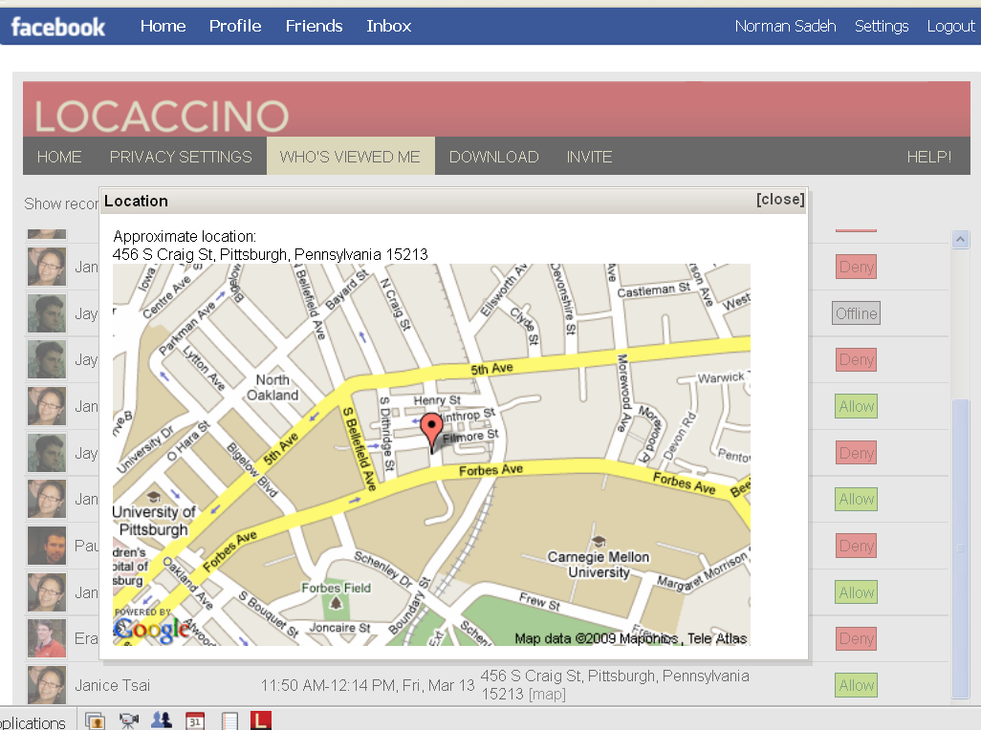
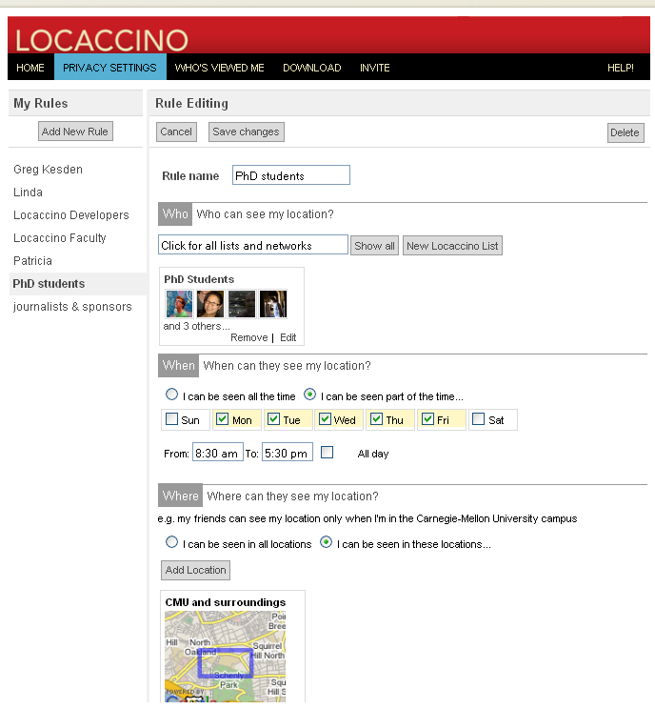
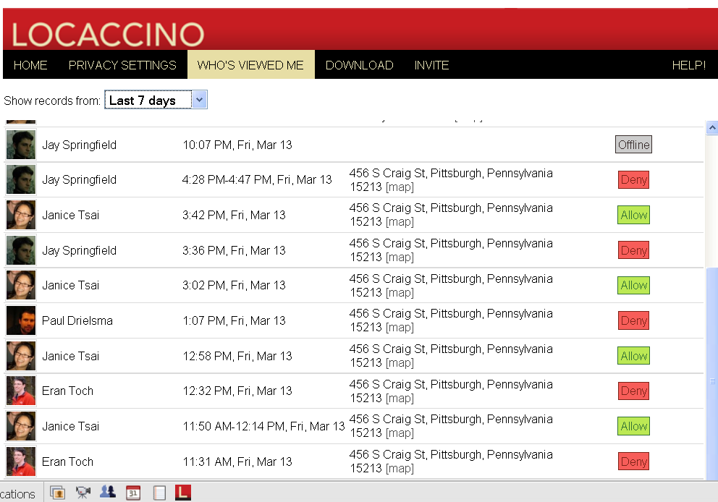
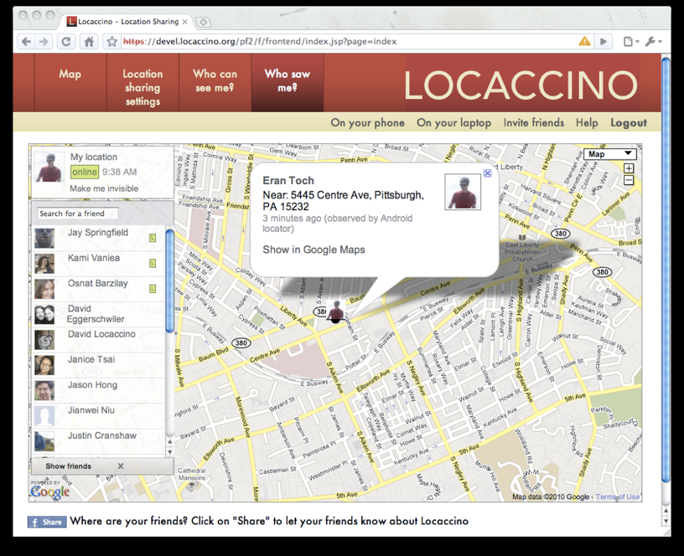
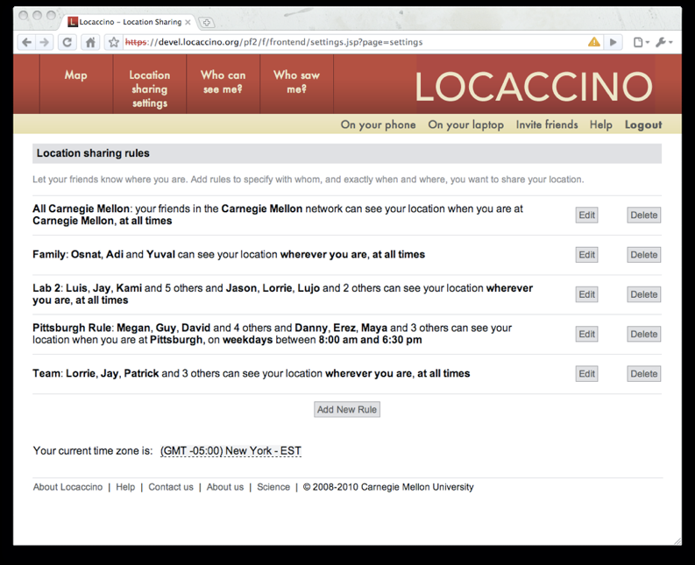

Slide 7
Some Sub-Questions
How rich are people’s privacy preferences?
  Determine which settings to expose to users
  Do people really care about privacy?
How diverse are people’s preferences?
  Can we identify good defaults policies?
Can we get users to tweak their policies?
Can we get users to adopt safer privacy practices?

Slide 8
How Rich Are People’s Policies?
Michael Benisch, Patrick Gage Kelley, Norman Sadeh, Lorrie Faith Cranor. Capturing Location Privacy Preferences: Quantifying Accuracy and User Burden Tradeoffs. Journal of Personal and Ubiquitous Computing, 2011

Slide 9

Privacy Mechanism
A function that enforces a privacy policy
Where are you @ 4pm?
Expression
Time attribute
Location attribute
Grant/Deny
Mechanism
Notes:
9

Slide 10
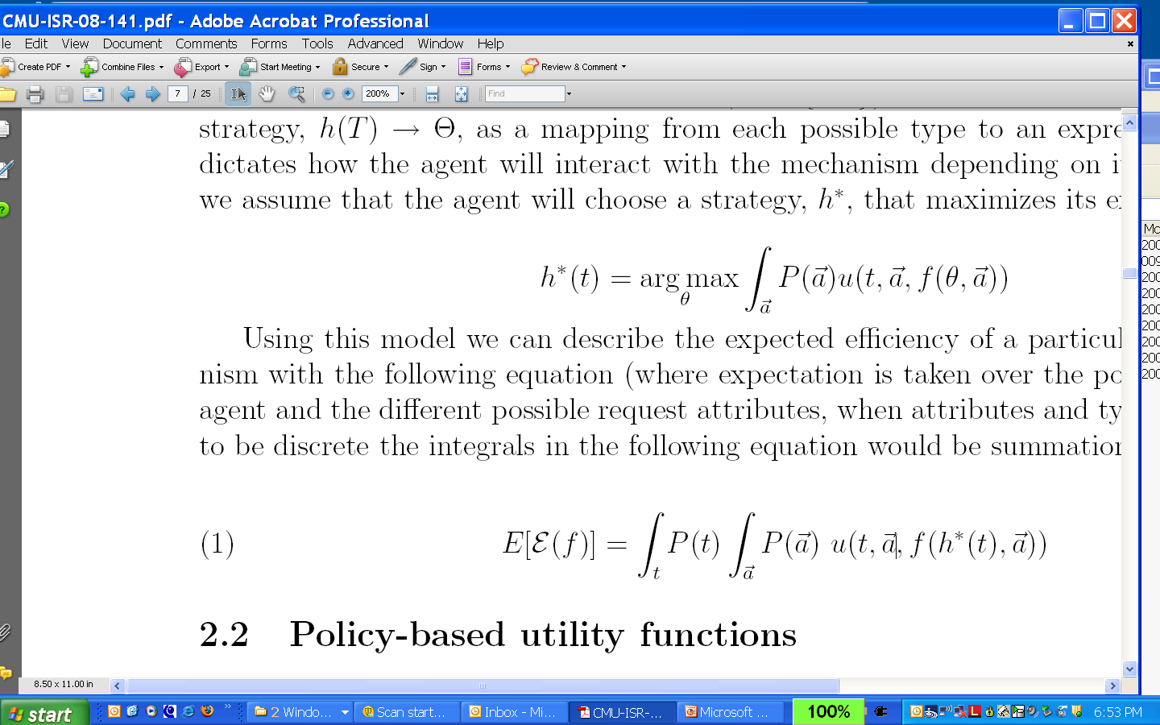
Expressiveness and Efficiency
Privacy mechanism: f(θ,a) decides on an outcome based on a user’s stated preferences (e.g. set of rules) θ and the context a of a request (e.g requester, time)
Rational user assumption: users define policies that take full advantage of available expressiveness
Efficiency: How well do we capture the ground truth preferences of a user population given an expected distribution of requests

Slide 11
Methodology for Designing Expressive Policy Mechanisms – version 1
Collect ground truth preferences for a representative sample of the user population
For different levels of expressiveness, compute the expected efficiency of the policies users would be able to define
  Assume rational users
  Search algorithm to identify optimal policies
  Select among different levels and types of expressiveness based on the above

Slide 12
Value of Richer Privacy Settings
Data from 27 users over 3 weeks – cell phones – GPS & WiFi
Assumes that an erroneous disclosure is 20x worse than an erroneous non-disclosure & fully “rational” user

Slide 13
Higher Accuracy Also Means More Sharing
People tend to err on the safe side
Explains lack of adoption of Loopt & Latitude

Slide 14
Expressiveness Helps More When Data is More Sensitive
Loc/Time+
Loc/Time
Time+
Loc
Time+
White list
Notes:
14

Slide 15
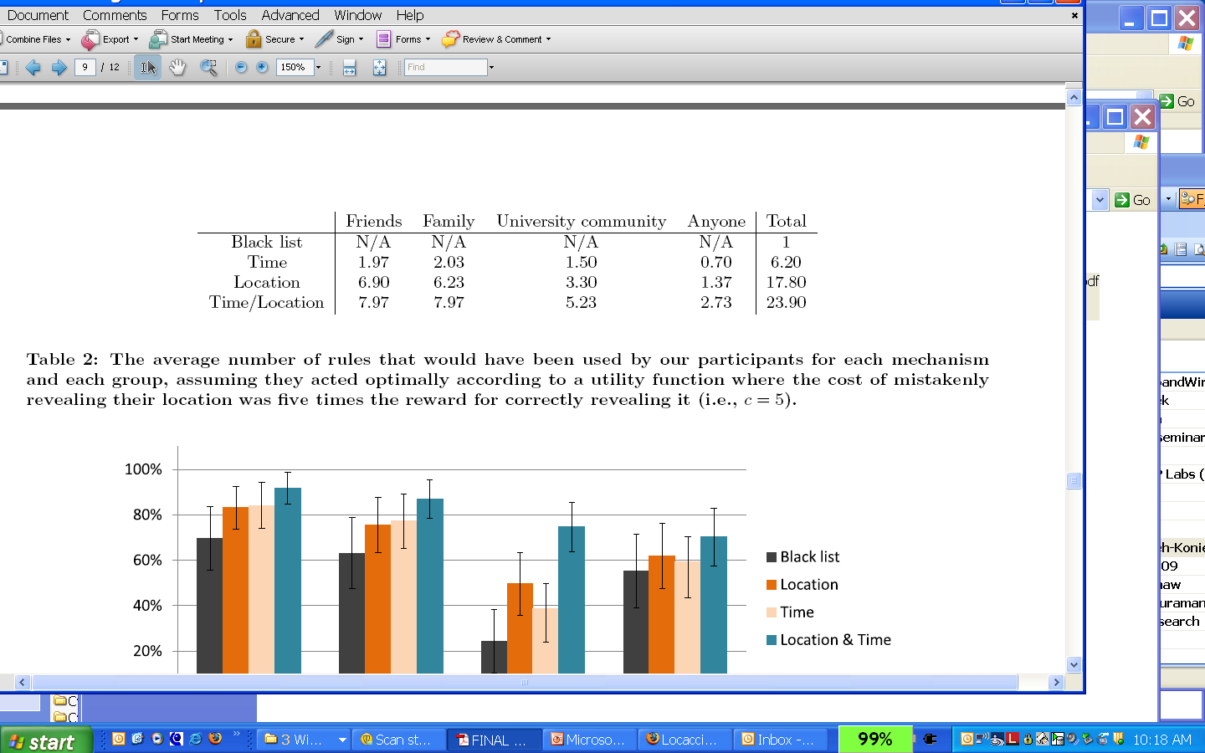
Taking Into Account User Burden
User burden considerations may lead us to select less expressive mechanisms.
How can we guide the design process?

Slide 16
Revised Methodology (“version 2”)
Rational user assumption: users define policies that take full advantage of available expressiveness
Relaxing the Rational User Assumption: A user’s strategy h*(t) is no longer the “optimal” strategy but instead the best strategy the user can define subject to some constraints
  Example: limit on the number of rules or amount of time → Revised Search Algorithm
  To be informed by human subject studies

Slide 17
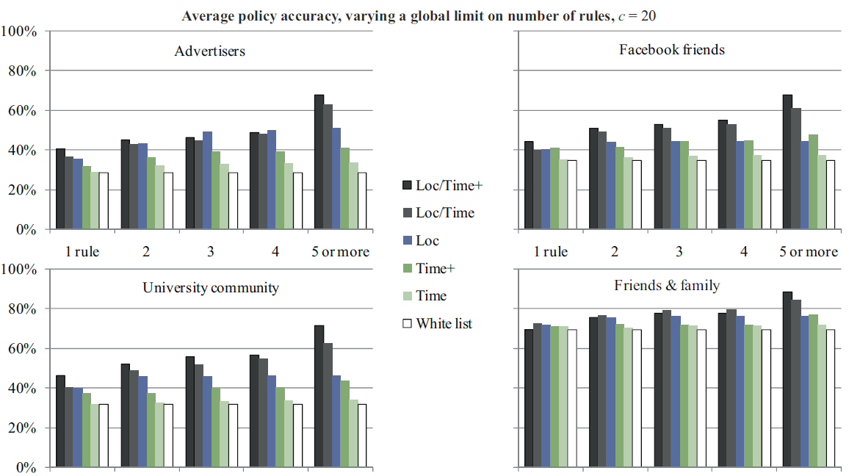
With User Burden Considerations – Number of Rules

Slide 18
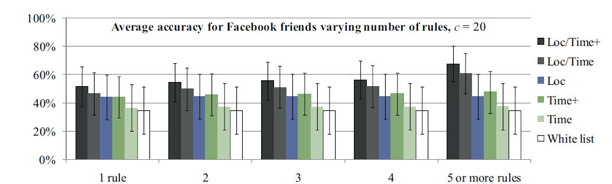
Same Analysis for Facebook Friends Only
It takes a smaller number of rules to see a difference when
the rules are only used for a single group (e.g. Facebook friends)

Slide 19
Do Users Fully Leverage More Expressive Settings?
No: Depends on the user, the user interface, amount of time, tolerance for error, etc.
How can we help users make the most of the settings they are given?

Slide 20
Can We Entice Users to Tweak their Policies?
Janice Tsai, Patrick Kelley, Paul Hankes Drielsma, Lorrie Cranor, Jason Hong, and Norman Sadeh.
Who’s Viewed You? The Impact of Feedback in a Mobile-location System. CHI ’09.

Slide 21
Could Auditing Help?
Users do not always know their own policies
Users do not fully understand how their rules will operate in practice
Auditing (‘feedback’) functionality may help users better understand the behaviors their policies give rise to

Slide 22
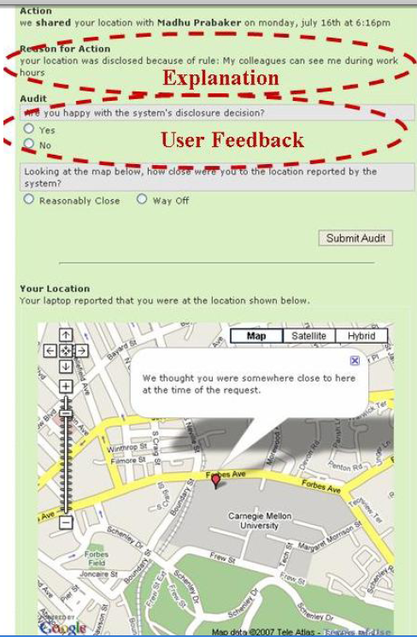
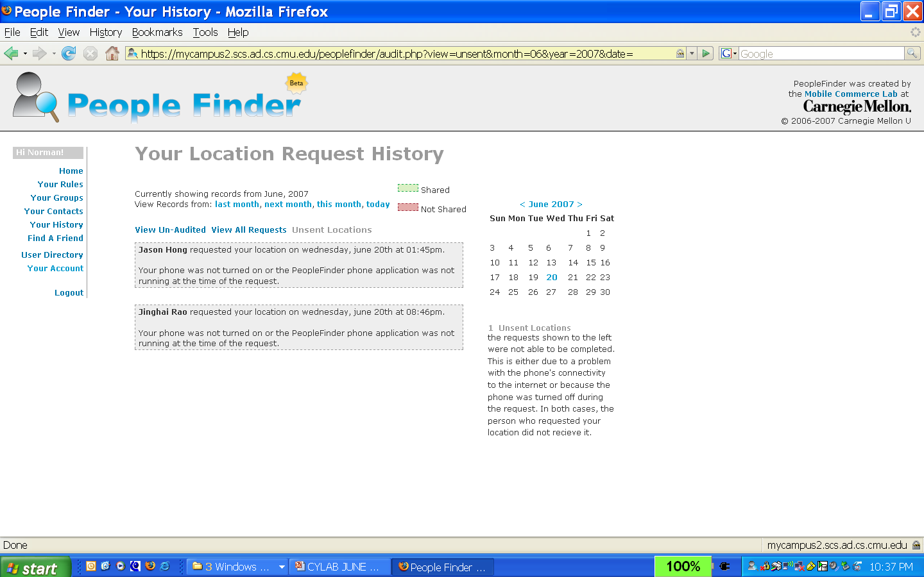
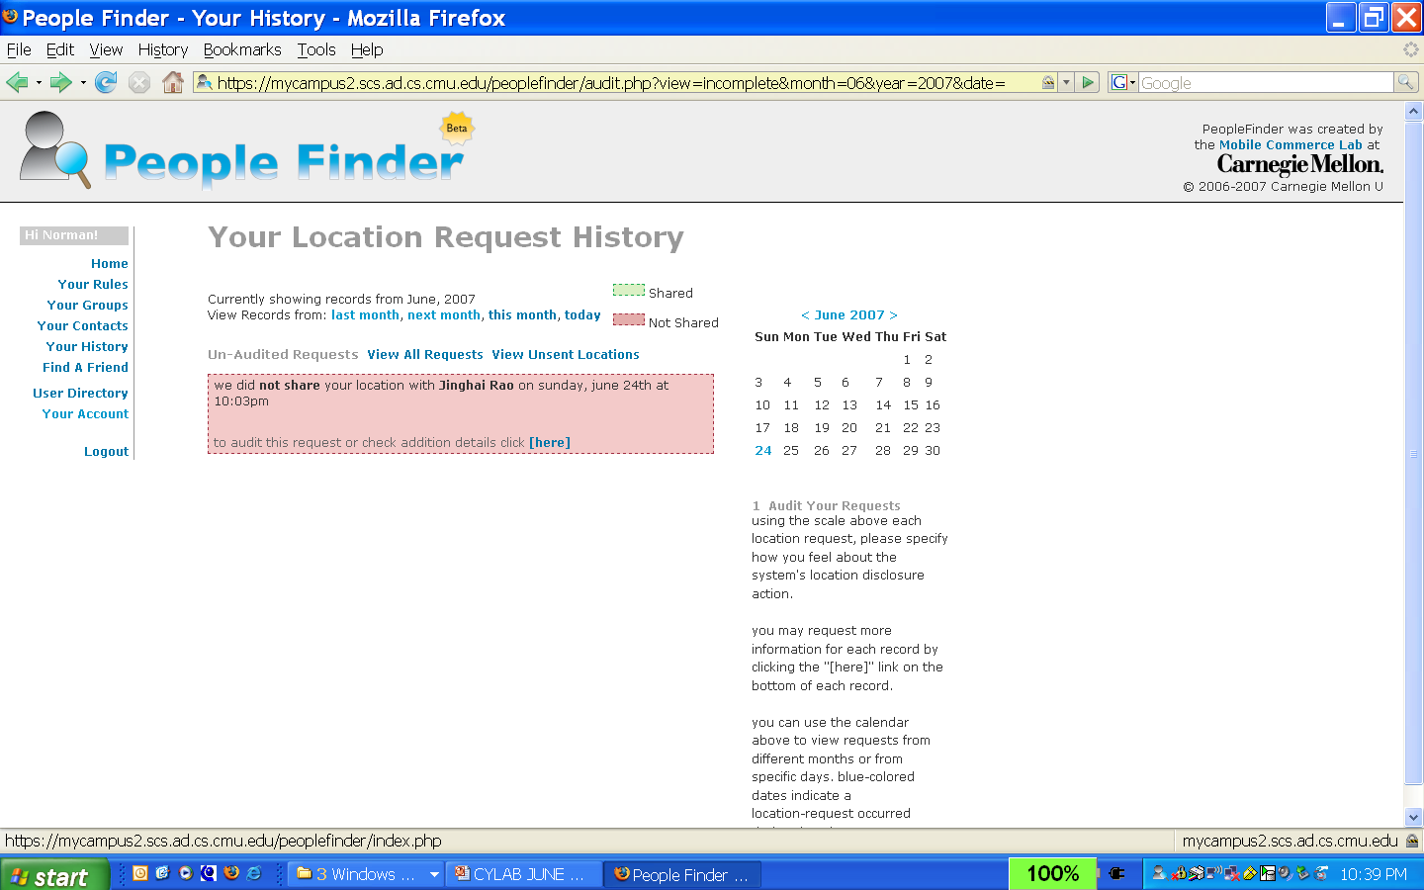
Feedback Through Audit Logs

Slide 23
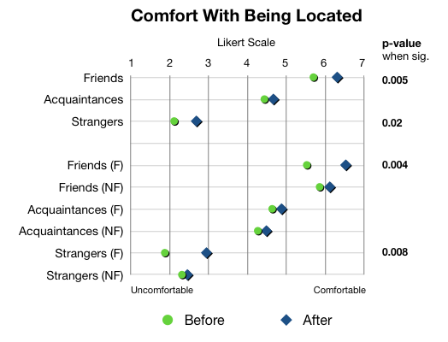
Evaluating the Usefulness of Feedback: Before/After Surveys – Facebook Study
Overall (F & NF)
F=w. fdbk
NF= w/o fdbk
56 Facebook users divided into 2 groups: one w. (“F”) and one w/o (“NF”) access to a history of requests for their location

Slide 24
Evaluating the Usefulness of Feedback: Looking at People’s Privacy Rules – Facebook Study
Examining Users’ Privacy Rules at the end of the study
Auditing
No Auditing
Hours viewable per week
Average: 122 hr/week
Average: 101 hr/week

Slide 25
Evaluating the Usefulness of Feedback: Do People Want it?
76.9% of people who had “feedback” indicated they wanted to keep it
83.3% of those who didn’t have said they would like to have it

Slide 26
Policy Evolution – with feedback
Data for
12 most
active users
across 3 pilots
of PeopleFinder
Application
Norman Sadeh, Jason Hong, Lorrie Cranor, Ian Fette, Patrick Kelley, Madhu Prabaker, and Jinghai Rao. Understanding and Capturing People’s Privacy Policies in a Mobile Social Networking Application Journal of Personal and Ubiquitous Computing 2009.

Slide 27
Contrast this with Android or the iPhone
Users expected to agree upfront
Coarse 24-hour audit

Slide 28
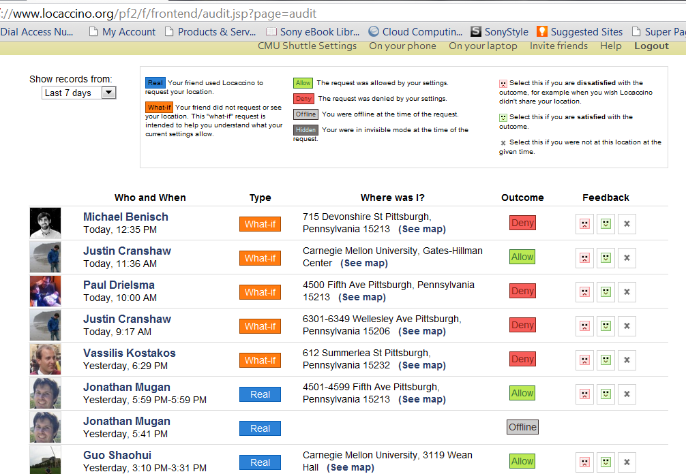
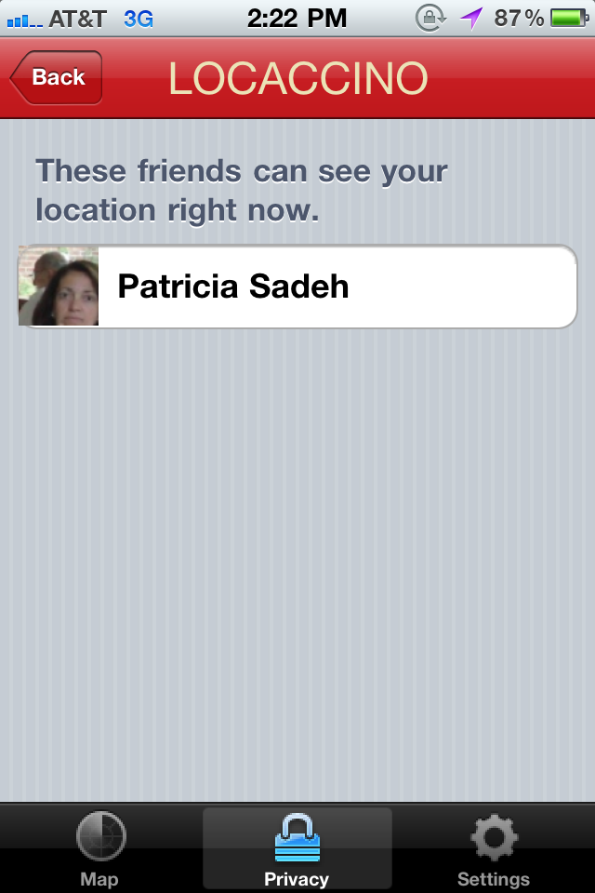
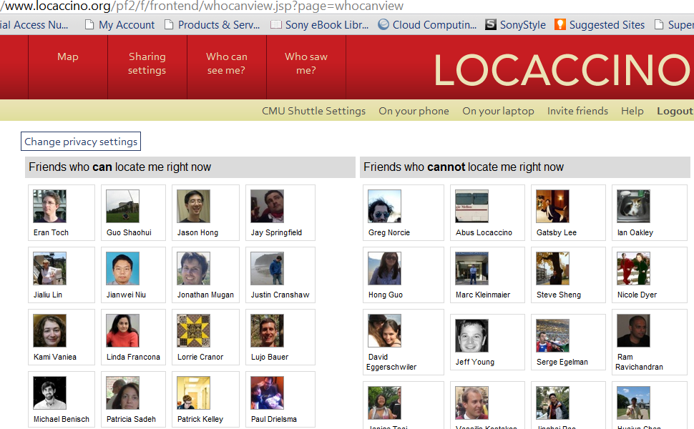
Locaccino Today

Slide 29
Can We Reduce User Burden?

Slide 30
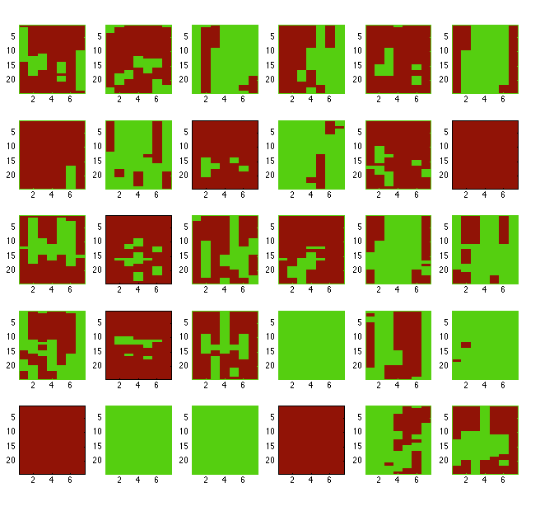
Can You Find a Default Policy?
Location sharing with members of the campus community – 30 different users
Green: Share
Red: Don’t

Slide 31
Clustering Canonical Policies – Privacy Personas
  Canonical locations, days of the week and times of the day: Morning, home, work, weekday, lunch time
Ramprasad Ravichandran, Michael Benisch, Patrick Gage Kelley, and Norman M. Sadeh. Capturing Social Networking Privacy Preferences: Can Default Policies Help Alleviate Tradeoﬀs between Expressiveness and User Burden? PETS ’09.

Slide 32
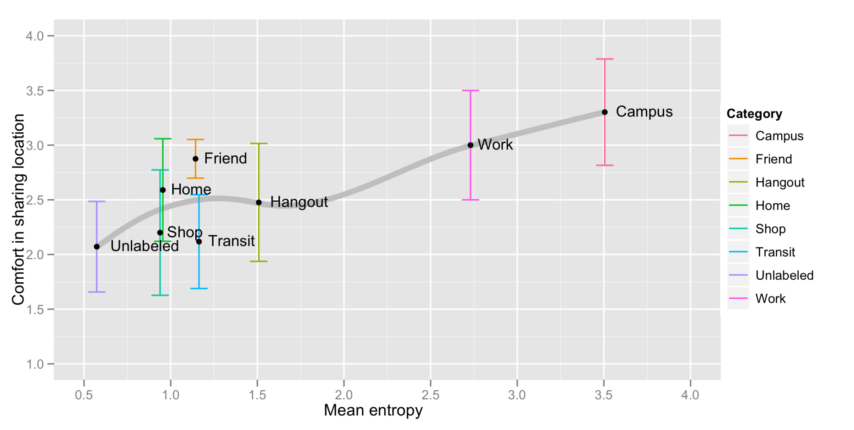
Do Locations Have Intrinsic Privacy Preferences?
Location entropy as a possible predictor
E. Toch, J. Cranshaw, P.H. Drielsma, J. Y. Tsai, P. G. Kelley, L. Cranor, J. Hong, N. Sadeh, "Empirical Models of Privacy in Location Sharing", in Proceedings of the Twelfth International Conference on Ubiquitous Computing. Ubicomp 2010

Slide 33
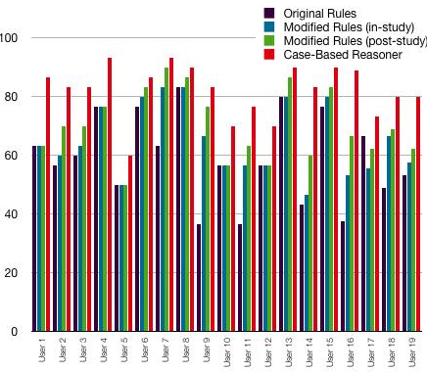
Question: Can Machine Learning Help?

Slide 34
User-Controllable Policy Learning (patent pending)
Learning traditionally configured as a “black box” technology
Users are unlikely to understand the policies they end up with
  Major source of vulnerability
Can we develop technology that incrementally suggests policy changes to users?
  Tradeoff between rapid convergence and maintaining policies that users can relate to

Slide 35
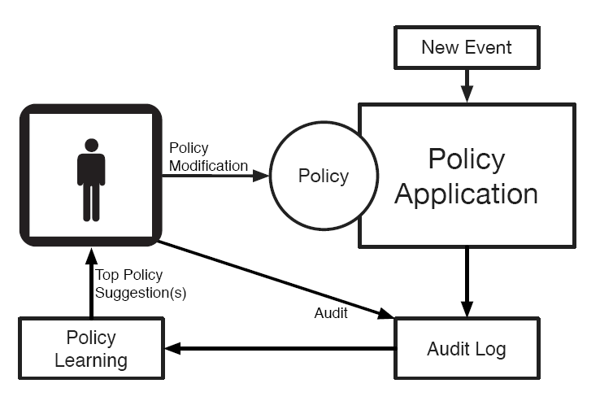
User-Controlled Policy Learning (patent pending)

Slide 36
Suggesting Rule Modifications based on User Feedback (patent pending)
Friends
John
Mike
Steve
Dave
Pat
Possible rule
modification
Possible
new rule
Possible
new group
Spouse
Sue
Colleagues
Helen
Chuck
Mike
Mon
Tue
Wed
Thu
Fri
Sat
Sun
Legend:
Access granted
Suggested Rule Change
Audited Request
Audit says Deny Access
Audit says Grant Access

Slide 37
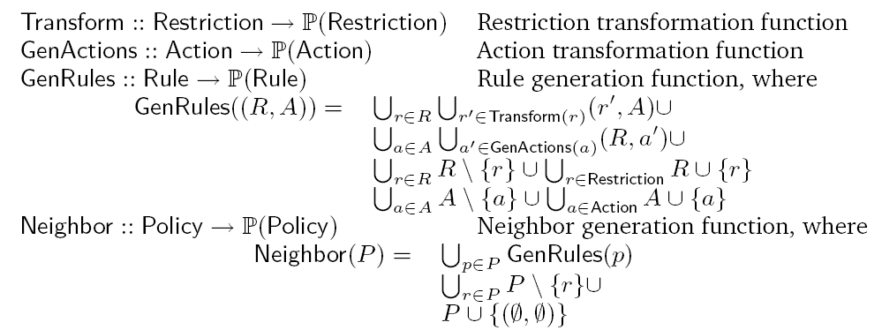
Exploring Neighboring Policies: Users Are More Likely to Understand Incremental Changes
Rate neighboring policies based on:
Accuracy
Complexity
Distance from current policy
Emphasis on
keeping changes
understandable

Slide 38
With Suggestions for Policy Refinement
Patrick Kelley, Paul Hankes Drielsma, Norman Sadeh, Lorrie Cranor. User Controllable Learning of Security and Privacy Policies. AISec 2008.

Slide 39
Summary
Users are not very good at specifying policies
  Vulnerability
Tradeoffs between expressiveness and user burden
  Quantifying the benefits of additional expressiveness can help
Auditing functionality helps
  Including Asking questions
    Why/Why not? What if?
User-understandable personas/profiles
User-Controllable Learning - Suggestions
  Moving away from machine learning as a black box

Slide 40
Some Ongoing Work
Evaluating combinations of the solutions presented today
Nudging Users towards safer practices
  “Soft paternalism”
  Can we provide users with feedback that nudges them towards safer practices
  Can we identify default policies that are biased towards safer practices?
Modulate Location Names:
  More than just privacy
  Joint work with Jialiu Lin and Jason Hong
Understanding Cultural Differences
  China-US study

Slide 41
Concluding Remarks
…This talk focused solely on location!
Mobile computing and social networking: a wide range of data sharing scenarios
Vision: Intelligent privacy agents
  Help scale to interactions with a large number of apps and services
  Learn user models
  Can selectively enter in dialogues with users and nudge them towards safer practices

Slide 42

Q&A
Funding
US National Science Foundation, the US Army Research Office, CMU CyLab, Microsoft, Google, Nokia, FranceTelecom, and ICTI
Collaborators
Faculty: Lorrie Cranor, Jason Hong, Alessandro Acquisti
Post-Docs: Paul Hankes Drielsma, Eran Toch, Jonathan Mugan
PhD Students: Patrick Kelley, Jialiu Lin, Janice Tsai, Michael Benisch, Justin Cranshaw, Ram Ravichandran, Tarun Sharma
Staff: Jay Springfield (research programmer) and Linda Francona (Lab manager)
Spinoff
The User-Controllable Privacy Platform on top of which Locaccino
is built is now commercialized by Zipano Technologies.

Slide 43
Relevant Publications - I
Norman Sadeh, Jason Hong, Lorrie Cranor, Ian Fette, Patrick Kelley, Madhu Prabaker, and Jinghai Rao. Understanding and Capturing People’s Privacy Policies in a Mobile Social Networking Application Journal of Personal and Ubiquitous Computing 2009.
Ramprasad Ravichandran, Michael Benisch, Patrick Gage Kelley, and Norman M. Sadeh. Capturing Social Networking Privacy Preferences: Can Default Policies Help Alleviate Tradeoﬀs between Expressiveness and User Burden? PETS ’09.
Patrick Kelley, Paul Hankes Drielsma, Norman Sadeh, Lorrie Cranor. User Controllable Learning of Security and Privacy Policies. AISec 2008.
Michael Benisch, Patrick Gage Kelley, Norman Sadeh, Lorrie Faith Cranor. Capturing Location Privacy Preferences: Quantifying Accuracy and User Burden Tradeoffs. CMU-ISR Tech Report 10-105, March 2010. Accepted for publication in Journal of Personal and Ubiquitous Computing
Janice Tsai, Patrick Kelley, Paul Hankes Drielsma, Lorrie Cranor, Jason Hong, and Norman Sadeh.
Who’s Viewed You? The Impact of Feedback in a Mobile-location System. CHI ’09.
Jason Cornwell, Ian Fette, Gary Hsieh, Madhu Prabaker, Jinghai Rao, Karen Tang, Kami Vaniea, Lujo Bauer, Lorrie Cranor, Jason Hong, Bruce McLaren, Mike Reiter, and Norman Sadeh. User-Controllable Security and Privacy for Pervasive Computing. The 8th IEEE Workshop on Mobile Computing Systems and Applications (HotMobile 2007). 2007.
Norman Sadeh, Fabien Gandon and Oh Buyng Kwon. Ambient Intelligence: The MyCampus Experience School of Computer Science, Carnegie Mellon University, Technical Report CMU-ISRI-05-123, July 2005.

Slide 44
Relevant Publications - II
P. Gage Kelley, M. Benisch, L. Cranor and N. Sadeh, “When Are Users Comfortable Sharing Locations with Advertisers”, in Proceedings of the 29th annual SIGCHI Conference on Human Factors in Computing Systems, CHI2011, May 2011. Also available as CMU School of Computer Science Technical Report, CMU-ISR-10-126 and CMU CyLab Tech Report CMU-CyLab-10-017.
J. Cranshaw, E. Toch, J. Hong, A. Kittur, N. Sadeh, "Bridging the Gap Between Physical Location and Online Social Networks", in Proceedings of the Twelfth International Conference on Ubiquitous Computing. Ubicomp 2010
E. Toch, J. Cranshaw, P.H. Drielsma, J. Y. Tsai, P. G. Kelley, L. Cranor, J. Hong, N. Sadeh, "Empirical Models of Privacy in Location Sharing", in Proceedings of the Twelfth International Conference on Ubiquitous Computing. Ubicomp 2010
Jialiu Lin, Guang Xiang, Jason I. Hong, and Norman Sadeh, "Modeling People’s Place Naming Preferences in Location Sharing", Proc. of the 12th ACM International Conference on Ubiquitous Computing, Copenhagen, Denmark, Sept 26-29, 2010.
Karen Tang, Jialiu Lin, Jason Hong, Norman Sadeh, Rethinking Location Sharing: Exploring the Implications of Social-Driven vs. Purpose-Driven Location Sharing. Proc. of the 12th ACM International Conference on Ubiquitous Computing, Copenhagen, Denmark, Sept 26-29, 2010.

