Slide 1
Improving the Privacy of
Wireless Protocols
Srinivasan Seshan (and many collaborators)
Carnegie Mellon University

Slide 2
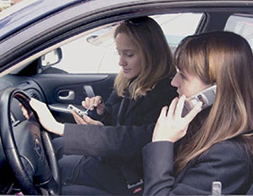



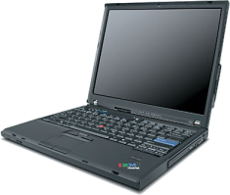
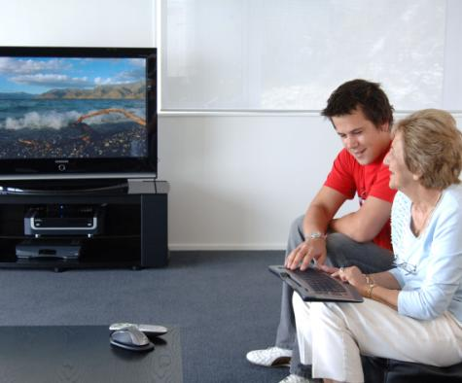
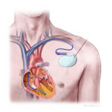









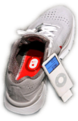

tcpdump
Protocol Header
Blood pressure: high
Protocol Header
Buddy list: Alice, Bob, …
Protocol Header
Protocol Control Info
Protocol Header
Protocol Control Info
Protocol Header
Home location=(47.28,…
Notes:
More and more personal devices are being equipped with wireless capabilities like 802.11 and bluetooth. They include everything from media players and ipods to sensors on our clothing and our bodies.
Because of this trend, we now often carry wireless devices with us where ever we go, from our homes to our cars and even to places that we think should have more privacy.
Unfortunately, in this emerging wireless world, bad guys still exist. They can easily overhear any of our wireless transmissions, often with nothing more than a laptop computer. Thus, without protection, an eavesdropper can easily obtain private information.

Slide 3

Link Layer Header
Protocol Header
Blood pressure: high
Protocol Header
Blood pressure: high
tcpdump
Link Layer Header
Protocol Header
PrivateVideo1.avi
Protocol Header
Protocol Control Info
Protocol Control Info
Link Layer Header
Protocol Header
PrivatePhoto1.jpg
Protocol Header
Protocol Control Info
Protocol Control Info
Link Layer Header
Protocol Header
Buddy list: Alice, Bob, …
Protocol Header
Buddy list: Alice, Bob, …
Link Layer Header
Protocol Header
Home location=(47.28,…
Protocol Header
Home location=(47.28,…
Notes:
To address this concern, most wireless protocols employ encryption to protect the payloads in packets that are transmitted.
However, protocol control information, in packet headers and during link setup, remain exposed. But this stuff is innocuous right? Can it reveal anything sensitive about us?

Slide 4
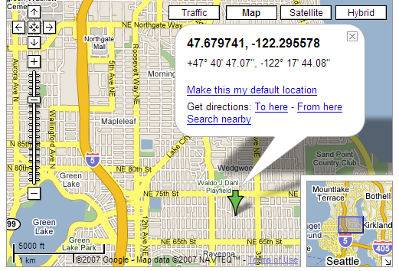
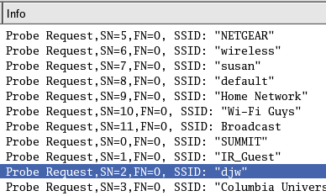
What can Protocol Control Info Reveal?
To speed association, done via SSIDs
  Sample data below from SIGCOMM 2004
Home
Set of SSIDs helps to identify user in terms of networks and places they’ve been
Cross-index with location databases (Wigle) for geographic information.

Slide 5
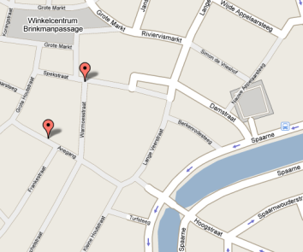


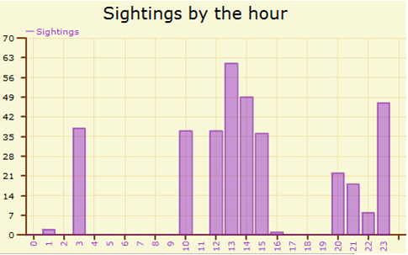

What can Protocol Control Info Reveal?
www.bluetoothtracking.org
Location traces can be deanonymized
[Beresford 03, Hoh 05-07, Krum 07]
Kim’s House
00:16:4E:11:22:33
Notes:
How to link to personal ident

Slide 6
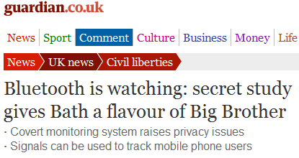
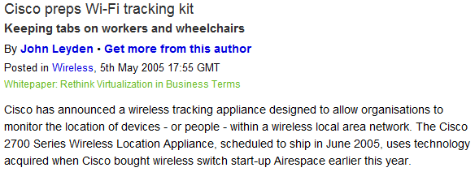



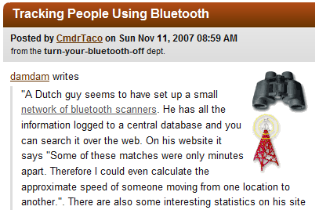
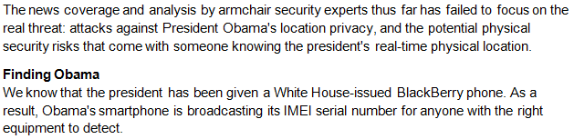
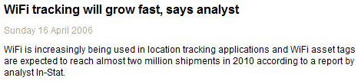


Who Might be Tracking You?
Notes:
Who might be tracking you? Well, you might be surprised to learn that some research institutions, employers, and individuals are already using some of this technology to keep tabs on people in the wild. For example, a guy and his friends set up a small tracking network in the netherlands. None these tracking networks are currently doing anything really evil, but it isn’t hard to imagine abuse since we can not control who tracks us. We are becoming more and more attached to our wireless devices, so it is likely that these threats will only grow in the future.

Slide 7
Outline
Quantifying the tracking threat
Building identifier-free protocols
Private crowd-sourcing

Slide 8



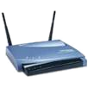

Best Security Practices Today
Bootstrap
Name: Alice’s Device
Secret: Alice<3Bob
Name: Bob’s Device
Secret: Alice<3Bob
Out-of-band (e.g., password, PIN)
Discover
From: 11:22:33:44:55:66
To: BROADCAST
Search probe
From: 11:22:33:44:55:66
To: BROADCAST
Announcement
Authenticate
and Bind
From: 11:22:33:44:55:66
To: AA:BB:CC:DD:EE:FF
Credentials, key exchange
⇒ K_{session}
From: AA:BB:CC:DD:EE:FF
To: 11:22:33:44:55:66
Credentials, key exchange
Use to encrypt
& authenticate
Send Data
From: 11:22:33:44:55:66
To: AA:BB:CC:DD:EE:FF
Confidentiality
Authenticity
Integrity
From: AA:BB:CC:DD:EE:FF
To: 11:22:33:44:55:66
Notes:
XXX: tie mac_address to encryption key in data phase, then flip symmetric key/public key, add O(k) notation on speed of algos
Delay anim
Name of devices
In general, there are 4 phases of wireless protocols. First, secrets or keys are bootstrapped in an out-of-band manner to enable all future communication. Then, each time a device is turned on, it tries to discover nearby devices using probes or announcements. For those that it discovers, it authenticates and binds a link to them to enable confidential and authenticated data traffic. This basic structure is used for not only ad hoc communication such as between game stations, but also between smaller devices using bluetooth such as phones and headsets, and infrastructure devices such as 802.11 access points.
Now, we see clearly here that one problem is that the device addresses are in the sender and recipient fields of each packet header, allowing an eavesdropper to easily overhear and track the devices.

Slide 9


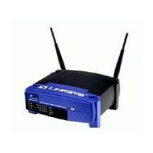

Identifiers
A well known technical problem
  Devices have unique and consistent addresses
  e.g., 802.11 devices have MAC addresses
  ➔ fingerprinting them is trivial!
MAC address now:
00:0E:35:CE:1F:59
MAC address later:
00:0E:35:CE:1F:59
tcpdump
tcpdump
Adversary
time

Slide 10
Identifiers
The widely proposed technical solution
  Pseudonyms: Change addresses over time
    802.11: Gruteser ’05, Hu ’06, Jiang ’07
    Bluetooth: Stajano ’05
    RFID: Juels ‘04
    GSM: already employed
MAC address now:
00:0E:35:CE:1F:59
MAC address later:
00:AA:BB:CC:DD:EE
?
tcpdump
tcpdump
time

Slide 11

Identifiers
Our work shows: Pseudonyms + WPA are not enough
  Implicit identifiers: identifying characteristics of traffic
  E.g., most users identified with 90% accuracy in hotspots
Search: “Bob’s Home Net”
Packets ⇒ Intel Email Server
…
Search: “Bob’s Home Net”
Packets ⇒ Intel Email Server
…
00:0E:35:CE:1F:59
00:AA:BB:CC:DD:EE
tcpdump
tcpdump
time

Slide 12
Implicit Identifiers by Example
Consider one user at SIGCOMM 2004
  Seen in an “anonymized” wireless trace
  (device addresses hashed, effectively a temporary address)
  Transferred 512MB via BitTorrent on a congested 802.11 network
  (Poor network etiquette?)
Can we still identify the culprit?
bittorrent transfer
00:0E:35:CE:1F:59
?
?
00:0E:35:CE:1F:59
00:0E:35:CE:1F:59
Notes:
To illustrate, let’s consider an example…

Slide 13
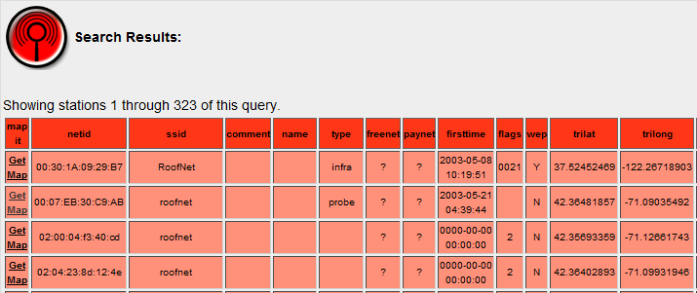
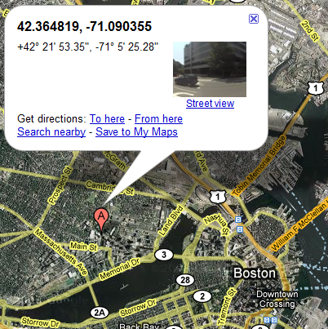
Tracking Example
Fingerprint: network names in probes
Wardriving Database
00:0E:35:CE:1F:59
Probe: “roofnet”
?
User of “roofnet”
community network at MIT
Notes:
Implicit identifier: SSIDs in probes
Set of SSIDs in 802.11 probe requests
Many 802.11 drivers search for preferred networks
Usually networks you have associated with before

Slide 14
Problem: Long-term Linkability
Bootstrap
Name: Bob’s Network
Secret: Alice<3Bob
Name: Alice’s Laptop
Secret: Alice<3Bob
Discover
From: 11:22:33:44:55:66
To: BROADCAST
Is Bob’s Network here?
Identifiers
needed for
rendezvous!
Search probe
From: 11:22:33:44:55:66
To: BROADCAST
Bob’s Network is here
Announcement
Authenticate
and Bind
From: 11:22:33:44:55:66
To: AA:BB:CC:DD:EE:FF
Credentials, key exchange
Identifiers
needed for
authentication!
Proof that I’m Alice
From: AA:BB:CC:DD:EE:FF
To: 11:22:33:44:55:66
Credentials, key exchange
Proof that I’m Bob
Send Data
From: 11:22:33:44:55:66
To: AA:BB:CC:DD:EE:FF
From: AA:BB:CC:DD:EE:FF
To: 11:22:33:44:55:66
Notes:
To see why these implicit identifiers exist, lets look at how wireless protocols work.
In general, there are 4 phases of wireless protocols. First, secrets or keys are bootstrapped in an out-of-band manner to enable all future communication. Then, each time a device is turned on, it tries to discover nearby devices using probes or announcements. For those that it discovers, it authenticates and binds a link to them to enable confidential and authenticated data traffic. This basic structure is used for not only ad hoc communication such as between game stations, but also between smaller devices using bluetooth such as phones and headsets, and infrastructure devices such as 802.11 access points.
Now, we see clearly here that one problem is that the device addresses are in the sender and recipient fields of each packet header, allowing an eavesdropper to easily overhear and track the devices.

Slide 15
Implicit Identifiers by Example
Implicit identifier: SSIDs in probes
  Set of SSIDs in 802.11 probe requests
  Many 802.11 drivers search for preferred networks
  Usually networks you have associated with before
00:0E:35:CE:1F:59
00:AA:BB:CC:DD:EE
SSID Probe:
“roofnet”
Bittorrent
transfer
?
tcpdump
tcpdump
time

Slide 16
Tracking Example
Fingerprint: IP broadcast packet sizes
  Set of broadcast packet sizes in network traffic
  e.g., advertisements by Apple Bonjour, iTunes, NetBIOS
00:0E:35:CE:1F:59
239 bytes
11:11:22:33:44:55
239 bytes
00:0E:35:CE:1F:59
245 bytes
11:11:22:33:44:55
245 bytes
00:0E:35:CE:1F:59
257 bytes
11:11:22:33:44:55
257 bytes
?
time

Slide 17


Problem: Short-term Linkability
Data packets in the same session remain linked;
in aggregate, these can be fingerprints
From: 12:34:56:78:90:ab
To: 11:22:33:44:55:66
500 bytes
From: 12:34:56:78:90:ab
To: 11:22:33:44:55:66
500 bytes
11:22:33:44:55:66
From: 00:00:99:99:11:11
To: 22:33:AA:BB:CC:DD
From: 00:00:99:99:11:11
To: 11:22:33:44:55:66
250 bytes
Source Address | Decryption key
12:34:56:78:90:ab | K_{Alice}
00:00:99:99:11:11 | K_{Charlie}
From: 12:34:56:78:90:ab
To: 11:22:33:44:55:66
200 bytes
From: 00:00:99:99:11:11
To: 22:33:AA:BB:CC:DD
From: 00:00:99:99:11:11
To: 11:22:33:44:55:66
250 bytes
From: 12:34:56:78:90:ab
To: 11:22:33:44:55:66
200 bytes
From: 00:00:99:99:11:11
To: 22:33:AA:BB:CC:DD
From: 00:00:99:99:11:11
To: 11:22:33:44:55:66
250 bytes
22:33:AA:BB:CC:DD
Notes:
A secondary problem is short-term linking. While information in a single encrypted packet is probably not identifying, we saw with broadcast packet sizes that in aggregate, the set or sequence of sizes can serve as a fingerprint.

Slide 18
Problem: Short-term Linkability
Bootstrap
Name: Bob’s Network
Secret: Alice<3Bob
Name: Alice’s Laptop
Secret: Alice<3Bob
Discover
From: 11:22:33:44:55:66
To: BROADCAST
Is Bob’s Network here?
Search probe
From: 11:22:33:44:55:66
To: BROADCAST
Bob’s Network is here
Announcement
Authenticate
and Bind
From: 11:22:33:44:55:66
To: AA:BB:CC:DD:EE:FF
Credentials, key exchange
Proof that I’m Alice
From: AA:BB:CC:DD:EE:FF
To: 11:22:33:44:55:66
Credentials, key exchange
Proof that I’m Bob
Send Data
From: 11:22:33:44:55:66
To: AA:BB:CC:DD:EE:FF
250 bytes
Identifiers
needed for
packet filtering!
From: AA:BB:CC:DD:EE:FF
To: 11:22:33:44:55:66
500 bytes
Notes:
To see why these implicit identifiers exist, lets look at how wireless protocols work.
In general, there are 4 phases of wireless protocols. First, secrets or keys are bootstrapped in an out-of-band manner to enable all future communication. Then, each time a device is turned on, it tries to discover nearby devices using probes or announcements. For those that it discovers, it authenticates and binds a link to them to enable confidential and authenticated data traffic. This basic structure is used for not only ad hoc communication such as between game stations, but also between smaller devices using bluetooth such as phones and headsets, and infrastructure devices such as 802.11 access points.
Now, we see clearly here that one problem is that the device addresses are in the sender and recipient fields of each packet header, allowing an eavesdropper to easily overhear and track the devices.

Slide 19

Fingerprint Accuracy
Developed an automated identification algorithm
  Based on Naïve Bayes classifier
  Fingerprints:
    network names
    broadcast packet sizes
    supported capabilities
Simulated user tracking with traffic from 500+ users
  Assume encryption and device address changes each hour
Was Alice here?
Known to be
from Alice
  Question: Given some traffic samples from a device,
  can we identify when it is present in the future?
Notes:
More generally, …

Slide 20
Fingerprint Accuracy
Results:
  53% of devices can be identified with 90% accuracy when at a small hotspot for the day
  (5 devices/hour)
  27% with 99% accuracy
  17% even if in a very busy hotspot (100 users/hour)
  More fingerprints exist
  ⇒ this is only a lower bound!
Was Alice here?
Known to be
from Alice
  Question: Given some traffic samples from a device,
  can we identify when it is present in the future?
Notes:
More generally, …

Slide 21
Is There a Common Defense?
Bootstrap
Name: Bob’s Network
Secret: Alice<3Bob
Name: Alice’s Laptop
Secret: Alice<3Bob
Discover
From: 11:22:33:44:55:66
To: BROADCAST
Is Bob’s Network here?
Search probe
From: 11:22:33:44:55:66
To: BROADCAST
Bob’s Network is here
Problem:
Long-term
Linkability
Announcement
Authenticate
and Bind
From: 11:22:33:44:55:66
To: AA:BB:CC:DD:EE:FF
Credentials, key exchange
Proof that I’m Alice
From: AA:BB:CC:DD:EE:FF
To: 11:22:33:44:55:66
Credentials, key exchange
Proof that I’m Bob
Send Data
From: 11:22:33:44:55:66
To: AA:BB:CC:DD:EE:FF
Problem:
Short-term
Linkability
From: AA:BB:CC:DD:EE:FF
To: 11:22:33:44:55:66

Slide 22
Goal: Make All Bits Appear Random
Bootstrap
Name: Bob’s Network
Secret: Alice<3Bob
Name: Alice’s Laptop
Secret: Alice<3Bob
Discover
No bits
linkable over
the long-term
Authenticate
and Bind
Many streams
overlap in
real traffic
⇒ much nosier
side-channels
Send Data
Notes:
We argue that we can make this entire class of attacks much more difficult to carry out if wireless protocols make all bits appear random to third parties. This includes all the packets sent for discovery and authentication and all bits in link layer headers. This is our goal.

Slide 23
Goal: Make All Bits Appear Random
Bootstrap
Name: Bob’s Network
Secret: Alice<3Bob
Name: Alice’s Laptop
Secret: Alice<3Bob
Discover
Identifiers
needed for
rendezvous!
Authenticate
and Bind
Identifiers
needed for
authentication!
Send Data
Identifiers
needed for
packet filtering!
Notes:
We argue that we can make this entire class of attacks much more difficult to carry out if wireless protocols make all bits appear random to third parties. This includes all the packets sent for discovery and authentication and all bits in link layer headers. This is our goal.
Assume other people around

Slide 24
Outline
Quantifying the tracking threat
Building identifier-free protocols
Private crowd-sourcing

Slide 25
Design Requirements
When A generates Message to B, she sends:
F(A, B, Message) → PrivateMessage
where F has these properties:
  Confidentiality: Only A and B can determine Message.
  Authenticity: B can verify A created PrivateMessage.
  Integrity: B can verify Message not modified.
  Unlinkability: Only A and B can link PrivateMessages
  to same sender or receiver.
  Efficiency: B can process PrivateMessages as fast
  as he can receive them.
A→B Header…
Unencrypted payload
Notes:
More specifically, what I mean…

Slide 26


Solution Summary
Confidentiality
Authenticity
Unlinkability
Integrity
Efficiency
Today’s protocols
(e.g., 802.11 WPA)
Only
Data
Payload
Only
Data
Payload
Only
Data
Payload
Temporary addresses
(e.g., [Gruteser 05, Jiang 07])
Only
Data
Payload
Only
Data
Payload
Only
Data
Payload
Finger-
prints
remain
Public Key
Symmetric Key
SlyFi: Discovery/Binding
SlyFi: Data packets
Notes:
So MAC Pseudonyms by themselves do not give us…
It is also non-trivial to combine pseudonyms and WPA because WPA exposes identifiers in the discovery and binding process

Slide 27
Straw man: Encrypt Everything
Bootstrap
Name: Alice’s Laptop
Secret: Alice<3Bob
Name: Bob’s Network
Secret: Alice<3Bob
K_{AB}
- Key for Alice→Bob
derive keys
K_{BA}
- Key for Bob→Alice
Idea: Use bootstrapped keys to encrypt everything
Notes:
To try to obtain the best of both worlds, we then may try to encrypt everything. After all, we already have…

Slide 28
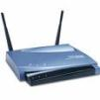






Straw man: Symmetric Key Protocol
Probe “Lucy”
Client
Service
Check MAC:
K_{AB}
Probe “Bob”
MAC:
K_{AB}
K_{Shared1}
K_{Shared2}
K_{Shared3}
…
K_{AB}
K_{SharedM}
Symmetric encryption
(e.g., AES w/ random IV)
Try to decrypt with each key (accounts + associations)
O(M)
Notes:
To address this problem, we might instead try to use symmetric key encryption, because it is much faster than public key encryption…

Slide 29
Straw man: Symmetric Key Protocol
Client
Service
Too slow!
(APs have 100s of accounts)
Check MAC:
K_{AB}
Probe “Bob”
MAC:
K_{AB}
K_{Shared1}
K_{Shared2}
K_{Shared3}
…
K_{AB}
K_{SharedM}
Symmetric encryption
(e.g., AES w/ random IV)
One key per sender (accounts + associations)
1.5 ms/packet (M=100)
(Need < 200 μs/packet for 802.11g)
Notes:
To address this problem, we might instead try to use symmetric key encryption, because it is much faster than public key encryption…

Slide 30


Straw man: Public Key Protocol
Client
Service
Probe “Bob”
Check signature:
K_{Alice}
Sign:
K⁻¹_{Alice}
Too slow in practice!
K_{Bob}
K⁻¹_{Bob}
Key-private encryption
(e.g., ElGamal)
Try to decrypt
O(1)
~100 ms/packet
Based on [Abadi ’04]
Notes:
FIX XXXX
One way we can do this is …

Slide 31
Solution Summary
Confidentiality
Authenticity
Unlinkability
Integrity
Efficiency
Only
Data
Payload
Only
Data
Payload
Only
Data
Payload
Today’s protocols
Only
Data
Payload
Only
Data
Payload
Only
Data
Payload
Finger-
prints
remain
Temporary addresses
Public Key Protocol
Symmetric Key Protocol
SlyFi: Discovery/Binding
SlyFi: Data packets
Notes:
So the encrypt everything approach

Slide 32
SlyFi
Symmetric key almost works, but tension between:
  Unlinkability: can’t expose the identity of the key
  Efficiency: need to identify the key to avoid trying all keys
Idea: Identify the key in an unlinkable way
Approach:
  Sender A and receiver B agree on tokens: T₁ , T₂ , T₃ , …
  A attaches T_{i} to encrypted packet for B
_{AB}
_{AB}
_{AB}
_{AB}
Notes:
To try to regain efficiency, we make the following observation: …
The key idea we leverage in our design of our solution slyfi is…

Slide 33
SlyFi
Required properties:
  Third parties can not link T_{i} and T_{j} if i ≠ j
  A doesn’t reuse T_{i}
  A and B can compute T_{i} independently
Client
Service
_{AB}
_{AB}
Check MAC:
_{AB}
K_{AB}
Probe “Bob”
_{AB}
MAC:
K_{AB}
Main challenge:
Sender and receiver must synchronize i
K_{AB}
K_{AB}
_{AB}
T_{i}
_{AB}
Lookup T_{i} in
hash table to get K_{AB}
Symmetric encryption
(e.g., AES w/ random IV)
_{AB}
150 μs/packet
(software)
T_{i} = AES(K_{AB}, i)
_{AB}
T_{i} = AES(K_{AB}, i)
Notes:
That is, SlyFi is basically the same as the symmetric key approach, but …

Slide 34

SlyFi: Data Transport
_{AB}
T₁
_{AB}
T ₂
_{AB}
_{AB}
_{AB}
_{AB}
_{AB}
i =
1
_{AB}
_{AB}
2
3
4
⇒
T ₃
…
T ₃
T ₂
T ₁
i =
1
T ₃
T ₄
T _{3+k}
2
3
4
_{AB}
hashtable
T ₄
Data messages:
  Only sent over established connections
  ⇒ Expect messages to be delivered
  ⇒ i = transmission number
On receipt of T_{i} , B computes next expected: T_{i+1}
Handling message loss?
  On receipt of T_{i} save T_{i+1}, … , T_{i+k} in table
  Tolerates k consecutive losses (k=50 is enough [Reis ‘06])
  No loss ⇒ compute one new token per reception
On receipt of T_{i} , B computes next expected: T_{i+1}
On receipt of T_{i} , B computes next expected: T_{i+1}
Handling message loss?
_{AB}
_{AB}
_{AB}
_{AB}
_{AB}
_{AB}
_{AB}
Notes:
For data messages we make the observation …
Worst case is disconnected

Slide 35
SlyFi: Discovery/Binding
_{AB}
Probe: “Bob’s Device”
Not here.
T₁
_{AB}
Probe: “Bob’s Device”
Not here.
T₂
...
_{AB}
Probe: “Bob’s Device”
T_{i}
i = ?
Discovery & binding messages:
  Often sent when other party is not present
  ⇒ Can’t rely on transmission reception to synchronize i
Notes:
We can not use the same approach for discovery and binding messages however, because discovery messages are often sent when the other party is not present. For example, Alice sends discovery probes whenever she opens up her laptop, even if bob is not present.

Slide 36
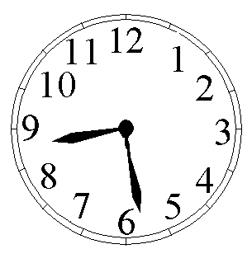
SlyFi: Discovery/Binding
_{AB}
Probe: “Bob’s Device”
T_{i}
i =
i =
⇒
_{AB}
_{AB}
_{AB}
T _{i-c}
…
T _{i}
T _{i+c}
hashtable
Discovery & binding messages:
  Infrequent: only sent when trying to associate
  Narrow interface: single application, few side-channels
  ⇒ Only require long-term unlinkability to prevent tracking
  ⇒ i = ⎣current time/1 min⎦
Handling clock skew:
  Receiver B saves T_{i-c}, … , T_{i+c} in table
  Tolerates clock skew of c minutes
  Steady state: compute one new token per minute
_{AB}
_{AB}
Notes:
We can not use the same approach for discovery and binding messages however, because discovery messages are often sent when the other party is not present. For example, Alice sends discovery probes whenever she opens up her laptop, even if bob is not present.

Slide 37
SlyFi: Putting it Together
Bootstrap
Name: Alice’s Laptop
Secret: Alice<3Bob
Name: Bob’s Network
Secret: Alice<3Bob
_{token}
_{encrypt}
_{auth}
K_{AB}
K_{AB}
K_{AB}
derive keys
_{token}
_{encrypt}
_{auth}
K_{BA}
K_{BA}
K_{BA}
T_{i} = AES(K_{AB} , i)
_{AB}
_{token}
_{AB}
_{encrypt}
Discover
T_{i}
nonce
from, to, capabilities, other protocol fields
Is Bob’s Network here?
Enc(K_{AB} ,nonce, …)
MAC(K_{AB} , …)
_{auth}
_{BA}
T_{i}
nonce
from, to, capabilities, other protocol fields
Bob’s Network is here
_{AB}
Authenticate
and Bind
T_{i}
nonce
from, to, capabilities, other protocol fields
Credentials, key exchange
⇒ K_{session1,2}
_{BA}
T_{i}
nonce
from, to, capabilities, other protocol fields
Credentials, key exchange
_{AB}
_{session1}
t_{i} = AES(K_{BA} , i)
_{AB}
_{session1}
_{AB}
Send Data
t₀
from, to, seqno, …
Enc(K_{AB} , t₀ , …)
MAC(K_{AB} , …)
_{session2}
_{BA}
t₀
from, to, seqno, …
Notes:
Those are the two key primitives that enable slyfi. Now I’ll just quickly show how we put them together. Here is the original wireless protocol we had earlier. First, we derive a set of keys from the secret exchanged; this is basically the same as existing protocols except we derive a set of keys for discovery in each direction and get a key for token generation, encryption, and message authentication codes.
Then we use the token generation key to compute discovery tokens using the time as the input. We also attach a nonce to each packet.
This is used to encrypt the remainder with the encryption key. By using a random nonce, this also appears to be random.
We do the same thing for authentication messages, where we generate and exchange a new session key between alice and bob.
Finally, we use the session key to generate tokens in the data phase. Here we use the transmission number rather than the time since the link has been setup. Note that we don’t need a separate nonce in this case because we are ensured that no token will be used twice. Thus the token effectively serves as a nonce.

Slide 38
Solution Summary
Confidentiality
Authenticity
Unlinkability
Integrity
Efficiency
Only
Data
Payload
Only
Data
Payload
Only
Data
Payload
Today’s protocols
Only
Data
Payload
Only
Data
Payload
Only
Data
Payload
Finger-
prints
remain
Temporary addresses
Public Key
Symmetric Key
SlyFi: Discovery/Binding
Long
Term
SlyFi: Data packets
Notes:
Thus, we conclude that slyfi is efficient. For discovery and binding, it also provides …

Slide 39
Outline
Quantifying the tracking threat
Building identifier-free protocols
Private crowd-sourcing

Slide 40
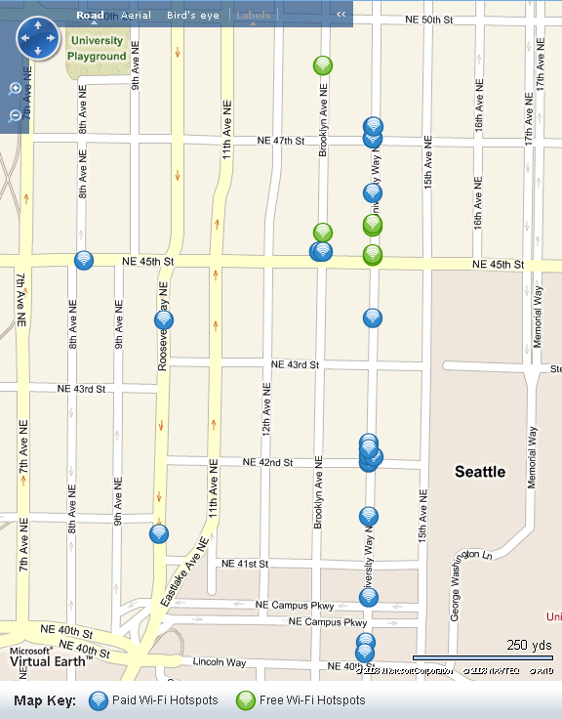
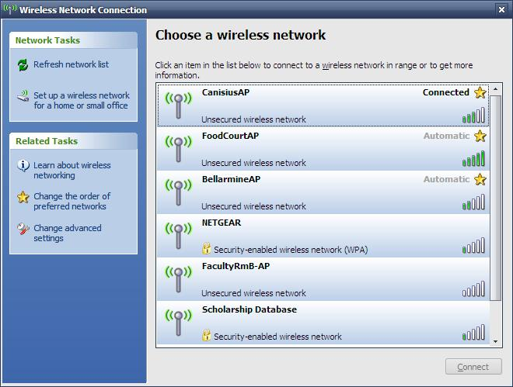
Problem: Commercial AP Selection
Jiwire.com
Hotspot database
$9.99
tmobile
$3.99
attwifi (ap 1)
Quality = ???
attwifi (ap 2)
linksys
Free!
seattlewifi
Free!
Free Public Wifi
Which networks will run my applications?
Which ones have good performance?
We often have many choices of wireless
access points (APs), but little information about each
Notes:
Many of us have been in the situation where we are in a new area and want to find wireless connectivity. We might do this by looking up hotspots in a directory service like Jiwire.com. Or we might just open up our laptop and see lots of wifi access points or APs. But today, we can’t know the performance that we will get at these hotspots before we go to them and even then, we may have to pay money first. This is because we can only see the quality of the wireless link, not its backhaul connectivity or if it rate-limits users. Only then might we determine whether or not that the AP that we selected has poor performance or blocks our applications.

Slide 41
Goal: Provide More Information
Improved
Hotspot database
Bandwidth: 300 kbps
Blocked ports: None
Bandwidth: 100 kbps
Blocked ports: None
Bandwidth: 30 kbps
Blocked ports: Email
tmobile
Bandwidth: 300 kbps
Blocked ports: None
attwifi (ap 1)
Bandwidth: 100 kbps
Blocked ports: None
Doesn’t work!
attwifi (ap 2)
Bandwidth: 300 kbps
Blocked ports: None
Doesn’t work!
linksys
Doesn’t work!
Bandwidth: 100 kbps
Blocked ports: Email, Skype
Bandwidth: 300 kbps
Blocked ports: None
seattlewifi
Bandwidth: 5 Mbps
Blocked ports: None
Free Public Wifi
Doesn’t work!
Doesn’t work!
Bandwidth: 300 kbps
Blocked ports: None
I need to use VoIP so this is the
best network for me
Doesn’t work!
Provide information about AP performance
and application support
Notes:
Our goal in this talk is to provide users with more information. That is, we would like to annotate hotspot directories with performance information about each AP. In addition, if users cache part of this directory while mobile, we would like them to accurately determine the performance information about APs that are visible so they can pick the best one.

Slide 42
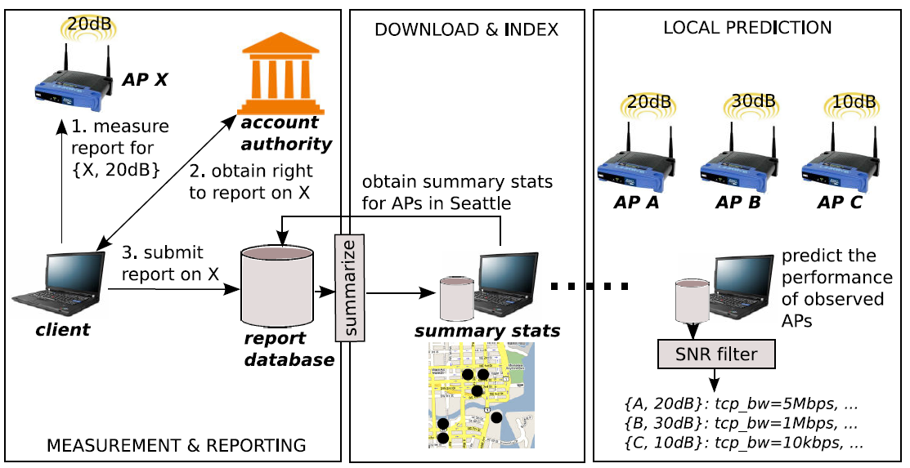
Goal: Wifi-Reports
Users automatically report on APs that they use
Notes:
One way to provide this information is to have users that use APs submit reports about them to a database. Future users can then obtain this information to predict their performance.
Our goal is to build such a system which we call wifi-reports. In such a system, first a client would measure the APs that he uses. Then, he would login to the service via an account authority, like Google. This account authority would give him the right to submit the report to a database where all reports would be summarized.
Future users can download and cache these summaries, like with the iPass hotspot client today. Then they can find the best APs nearby.

Slide 43




Design Challenges
Bob’s Report on AP5
Bandwidth: 300 kbps
Bob’s Report on AP3
Doesn’t work!
Bob’s Report on AP4
Doesn’t work!
Mallory’s Report on AP4
Bandwidth: 10 Mbps
Mallory’s Report on AP4
Bandwidth: 10 Mbps
Mallory’s Report on AP4
Bandwidth: 10 Mbps
Mallory’s Report on AP4
Bandwidth: 10 Mbps
Mallory’s Report on AP4
Bandwidth: 100 Mbps
Bob’s Report on AP2
Doesn’t work!
Bob’s Report on AP1
Doesn’t work!
  Location Privacy: Authority/databases cannot link a user’s reports
  Limited Influence: Only count 1 report per AP, per user
  Location Context: Account for wireless channel conditions
Notes:
Any such reporting system raises several challenges.
First, because the use of an AP implicitly reveals a location where a user has been, if a user’s identity is attached to reports then they may worry that the account authority or database can track them, or that a third party that compromises the database can track them. Since we don’t want to disincentivize users from participating, we would like to reassure them that they can not be tracked and their location privacy will be protected. To do this, we need to ensure that a user’s reports can’t be linked together.
Second, since we are relying on users to submit reports, we also need to limit the influence of some users that might be malicious. For example, the owner of a hotspot might submit lots of reports that say it is great even if it is not. One way to limit influence would be to make sure that each user can only submit one report per AP.
Finally, since we are dealing with wireless APs, location and channel conditions will affect measured performance. So we need to take these conditions into account.

Slide 44
Design Requirements
Mallory’s Report on AP4
Bandwidth: 10 Mbps
Mallory’s Report on AP4
Bandwidth: 10 Mbps
Mallory’s Report on AP4
Bandwidth: 10 Mbps
Mallory’s Report on AP4
Bandwidth: 10 Mbps
Mallory’s Report on AP4
Bandwidth: 100 Mbps
  Location Privacy: Authority/databases cannot link a user’s reports
  Limited Influence: Only count 1 report per AP, per user
  Location Context: Account for wireless channel conditions
Notes:
If we want to build a a report collection system then, we need to deal with the three challenges I mentioned at the beginning of the talk: how we can guarantee to users that their location privacy will be respected, how we can also limit the influence of individual users, and how we can take into account location context.

Slide 45

Straw men Protocols
Alice’s locations:
cafe1
tmobile #3
Bob’s Network
Alcohol Anon Net
CMU
…
authenticate Alice
Location Privacy
submit: R
If Alice has already submitted
a report on cafe1 then abort,
else save the report
measure cafe1
Anonymous
Report on cafe1
Bandwidth: 5 Mb
Anonymous
Report on cafe1
Bandwidth: 100 Mb
Anonymous
Report on cafe1
Bandwidth: 100 Mb
Anonymous
Report on cafe1
Bandwidth: 100 Mb
Anonymous
Report on cafe1
Bandwidth: 100 Mb
Anonymous
Report on cafe1
Bandwidth: 100 Mb
Anonymous
Report on cafe1
Bandwidth: 5 Mb
submit: R
mix network
R ← report on cafe1
Limited Influence
Notes:
Given these assumptions, we first try some simple protocols. The first thing we might try is to submit the reports over a mix network…

Slide 46



Report Protocol
starbucks2
List of all APs
cafe1
cafe2
cafe1
cafesolstice
tmobile #4
AT&T #54
⋅⋅⋅⋅
…
authenticate and
download list of APs
{k_{cafe1}, k⁻¹_{cafe1}} ← new key pair
Blind the token k_{cafe1} ⇒ T_{blind}
{k_{cafe2}, k⁻¹_{cafe2}} ← new key pair
…
request: cafe1, T_{blind}
If Alice requested cafe1 before
then abort
else sign the token ⇒ S_{blind}
reply: S_{blind}
Unblind the signature ⇒ S_{cafe1}
measure cafe1
submit:
cafe1, S_{cafe1}, k_{cafe1}, R, S_{R}
Report on cafe1
Bandwidth: 5 Mbps
Report on cafe1
Bandwidth: 5 Mbps
Verify the signatures
Delete old reports signed with k_{cafe1}
mix network
R ← report on cafe1
Sign the report ⇒ S_{R}
Notes:
To achieve both properties, we need to do something less obvious. First we assume that the account authority has a list of APs in the system. We can build this list and update it in the same way that hotspot directories build their lists today, e.g., by having the owners of hotspots add them.
Now, at some point either before or after using APs, Alice logs in and downloads the list.
For each AP in the list…
For clarity, we’ll just look at the token for cafe1, we do the same thing for each one she generates. The idea is that we require alice to sign reports for cafe1 with this token. To achieve…
To get these properties with respect to the account authority… Alice blinds the token…
The account authority signs the token but makes sure Alice can only request one token for cafe1. Although cafe1 is revealed in the request, the AA has no information about what it just signed.
Alice unblinds…
Then when Alice wants to submit a report…
Of course, all this can be done automatically by a software client.

Slide 47
Report Protocol
authenticate and
download list of APs
shinkatea
starbucks2
  Problem: Asking for a token reveals the target AP
  Solution: Ask for the tokens for all APs in a city
tullys
cafe1
request: cafe1, T_{blind}
UW
cafe2
…
reply: S_{blind}
APs in Seattle
measure cafe1
Report on cafe1
Bandwidth: 5 Mbps
Report on cafe1
Bandwidth: 5 Mbps
Report on cafe1
Bandwidth: 100 Mb
submit:
cafe1, S_{cafe1}, k_{cafe1}, R, S_{R}
  Problem: Some users may submit bad reports
  Solution: Robust summary functions (e.g., median)
mix network
Notes:
There are two details that we still need to deal with. First, obviously if Alice only requests tokens for APs that she visits, then the account authority still learns this information. So, instead, Alice requests tokens for all the APs in each city that she visits. This can be done before or after actually using APs. So the authority learns which cities she visits, but not any specific location.
Second, even malicious users can get one token for an AP. So we need some way to filter out these bad reports. To do this, the database can use summary functions that are robust to outliers, such as the median function for real valued metrics.

Slide 48
Summary
Slyfi
  How to build a WiFi replacement that reveals no transmitted bits to eavesdroppers
  Key challenge: ensuring efficient processing by both clients and Aps
Wifi-Reports
  How to build a crowdsourcing application that preserves privacy
  Key challenge: preventing malicious reports
Other relevant designs
  Geo-fencing – limiting wireless network coverage to well-defined regions

Slide 49
Backup Slides

Slide 50
Geo-fencing
Build on the “virtual walls” model of wireless for privacy [Kapadia’07]: goal is to approximately confine connectivity with “virtual walls”
  E.g., to an apartment, conference room, office
Prevents information reception outside intended service area for improved privacy and security
May be able to improve coverage within service area and reduce interference across service areas

Slide 51
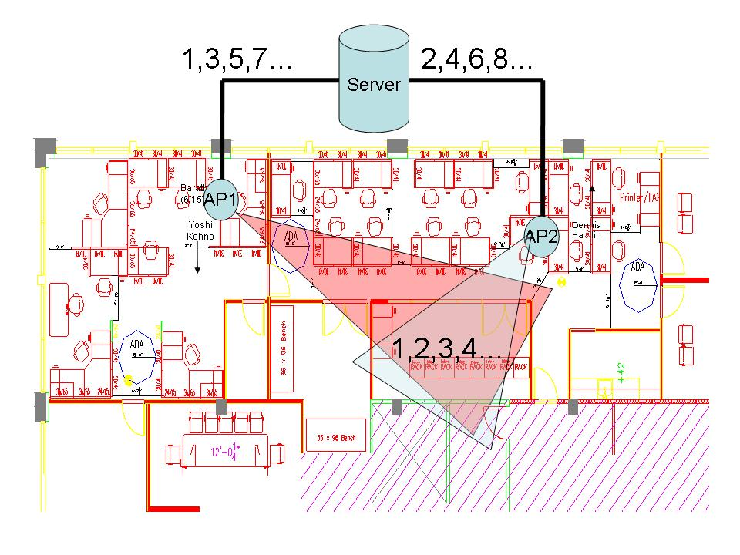
Geo-fencing
Use steerable directional antennas to focus signals on a specified region
Stripe data across antennas to provide coverage only in the region
Code the packets
transmitted by
the antennas to
prevent partial
information
retrieval

Slide 52
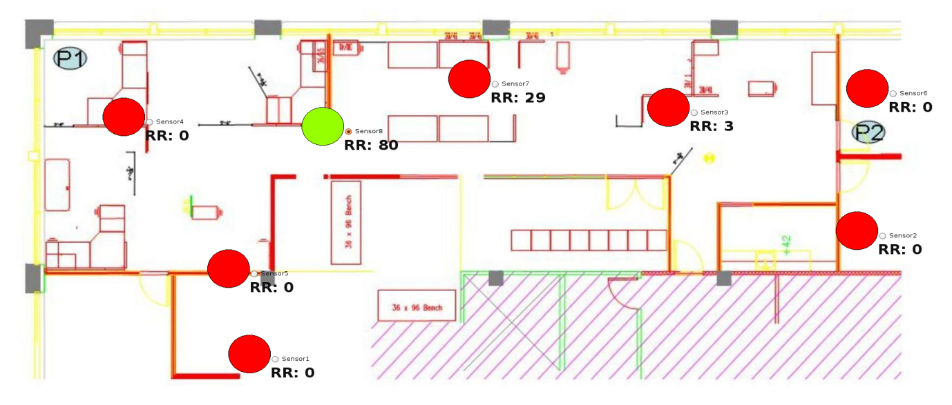
Geo-fencing Results
Coverage confined to
single location
Indoor multipath reflections significantly distort antenna radiation pattern
Need periodic tuning of the antenna directions to track changes in environment

Slide 53
Challenge: Filtering without Identifiers
Which packets are for me?
Which packets are for me?
Notes:
Why is this hard to do? Since no longer have source or destination addresses in packets, filtering packets efficiently becomes much more challenging.

Slide 54


Wireless Data Privacy
Third party can see the contents of your messages, e.g., email, credit card numbers
  Addressed by encryption for confidentiality
xxxxx
email
xxxxx
(Mary)
email
(Mary)
Traditional threat, assumed solved (soon)

Slide 55
Wireless Information Privacy
Third party can identity specific users or kinds of devices near a given location
  Due to unique signatures, e.g., addresses
Hey, Mary’s next door! She’s reading email
xxxxx
(Mary)
xxxxx
(Mary)
Less well known, point of our work
Notes:
Inventorying, presence, population, activity levels

Slide 56
Best Security Practices Today
Temporary Addresses:
[Gruteser 05, Hu 06, Jiang 07, Stajano 05]
Discover
From: 19:1A:1B:1C:1D:1E
To: BROADCAST
Search probe
From: 22:1E:3E:4F:A1:45
To: BROADCAST
Announcement
Authenticate
and Bind
From: 19:1A:1B:1C:1D:1E
To: 22:1E:3E:4F:A1:45
Credentials, key exchange
⇒ K_{session}
From: 22:1E:3E:4F:A1:45
To: 19:1A:1B:1C:1D:1E
Credentials, key exchange
Send Data
From: 19:1A:1B:1C:1D:1E
To: 22:1E:3E:4F:A1:45
Confidentiality
Authenticity
Integrity
From: 22:1E:3E:4F:A1:45
To: 19:1A:1B:1C:1D:1E
Notes:
Of course, these identifiers really only need to be consistent during a single session of the protocol, so Alice and Bob can change them each time they meet. This is how we can get temporary device addresses.

Slide 57
Implicit Identifiers by Example
Implicit identifier: network destinations
  IP <address, port> pairs in network traffic
  At SIGCOMM, each visited by 1.15 users on average
  Some nearly-unique destinations repeatedly visited
  (e.g., email server)
SSH/IMAP server:
159.16.40.45
SSH/IMAP server:
159.16.40.45
?
?
tcpdump
tcpdump
time
Notes:
Nearly-unique: or destinations visited by a very small number of people and thus distinguish them from others. For example, a school email server if you were the only person from that school at SIGCOMM

Slide 58
Implicit Identifiers by Example
Implicit identifier: broadcast packet sizes
  Set of 802.11 broadcast packet sizes in network traffic
  E.g., Windows machines NetBIOS naming advertisements; FileMaker and Microsoft Office advertise themselves
Broadcast pkt sizes:
239, 245, 257
Broadcast pkt sizes:
239, 245, 257
?
tcpdump
tcpdump
time

Slide 59
Implicit Identifiers by Example
Implicit identifier: MAC protocol fields
  Header bits (e.g., power management., order)
  Supported rates
  Offered authentication algorithms
Protocol Fields:
11,4,2,1Mbps, WEP
Protocol Fields:
11,4,2,1Mbps, WEP
?
tcpdump
tcpdump
time

Slide 60

How Bad Is The Situation?
Start with anonymized trace from SIGCOMM 2004. Hundreds of users over multiple days
Split into training data and validation data and traffic samples (1 hour)
Convert user identities to pseudonyms
Now train on other features and try to identify users in validation data
Use user identities in trace for ground truth to see how well we did
“A busy environment”

Slide 61
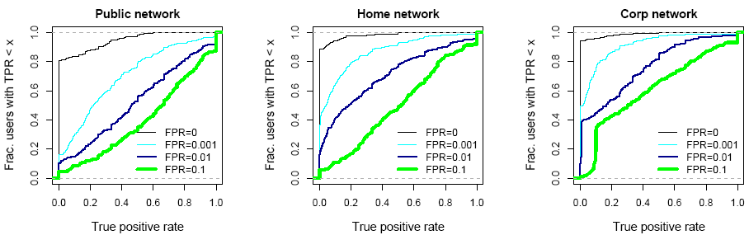
Features Combine to Find More Users
With all features, roughly half the users can be identified at least half the time (99% accuracy)
Some users emit highly specific features
  Easily found in a crowd
bcast + ssids
bcast + ssids +
fields
bcast + ssids +
fields + netdests
Notes:
Lower to the left is better

